Slide 1
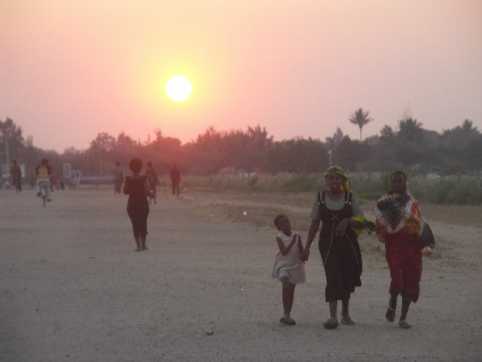
III. Overview of Survey & Analysis of Urban Transportation Planning
Transportation Survey
Overview of Transportation demand forecast
Evaluation System
Tetsuro HYODO
Tokyo University of Marine Science & Technology
Nov. 07, 2012

Slide 2
Brief Overview of This Module
Understanding Survey, Forecast and Evaluation Methods of Urban Transportation
・Objectives of transportation survey and five factors
・Principle, estimation method and software of transportation forecast
・Evaluation system – Meaning of cost-benefit analysis and the method

Slide 3

1.Transportation Survey
MⅢ-1

Slide 4
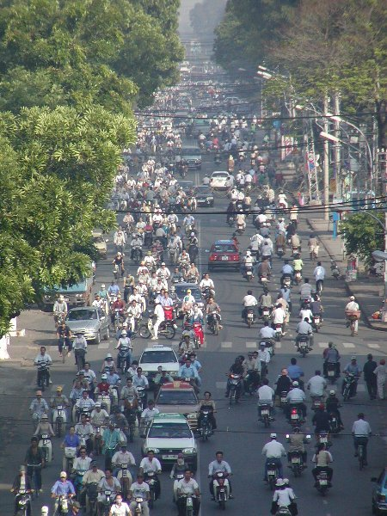
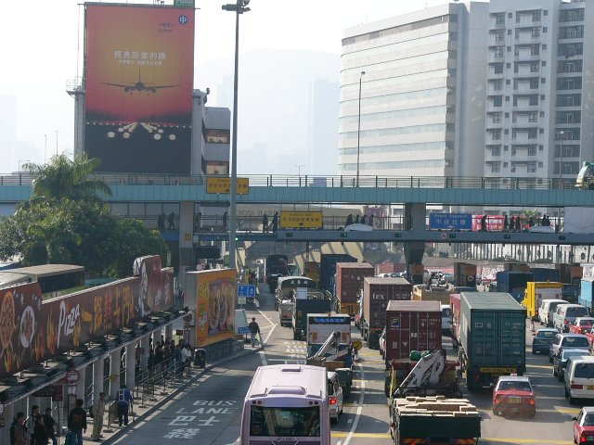
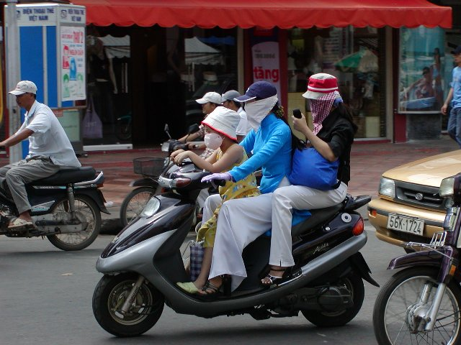
1. Background of Transportation Planning
- Transportation Problems in Urban Areas
Traffic Jams (Hong Kong)
Heavy Congestion
(Vietnam)
Environmental Problems (Vietnam)

Slide 5
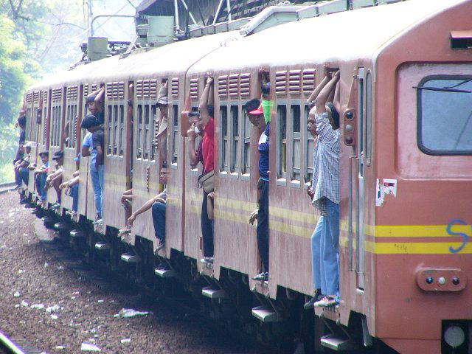
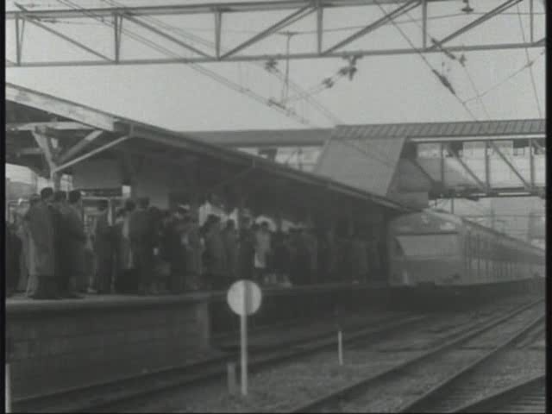
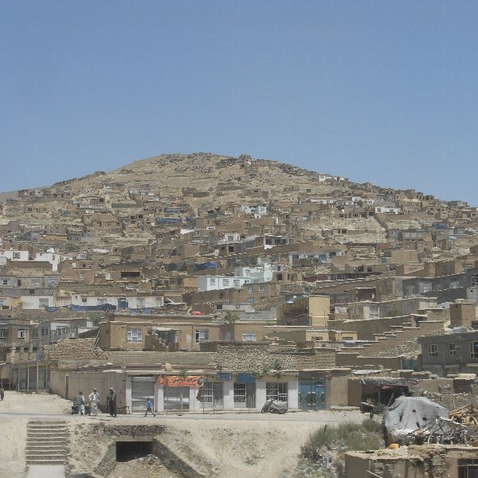
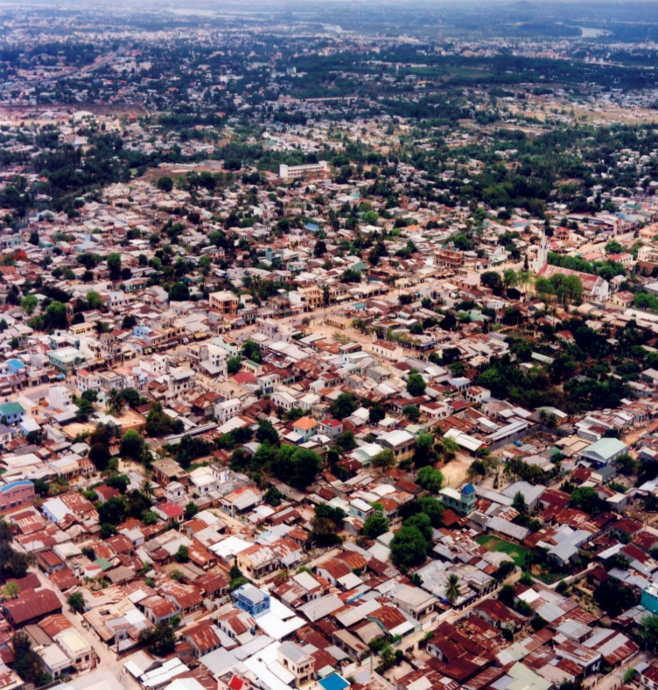
Safety or Manner Problems
(Indonesia)
Lack of Land Use control
(Left: Vietnam, Right: Afghanistan)

Slide 6
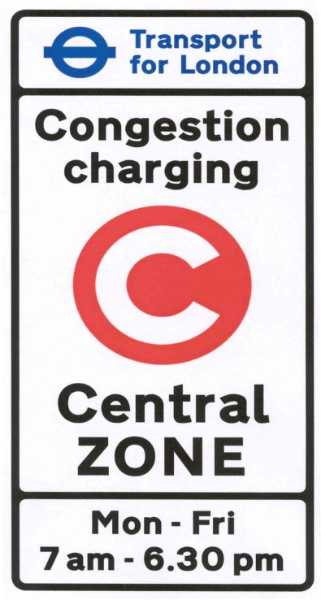
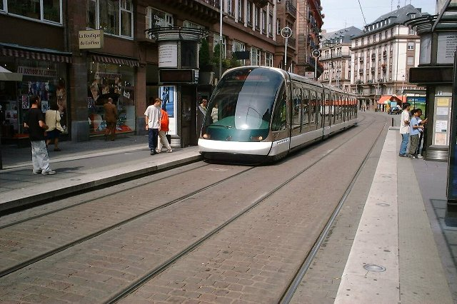
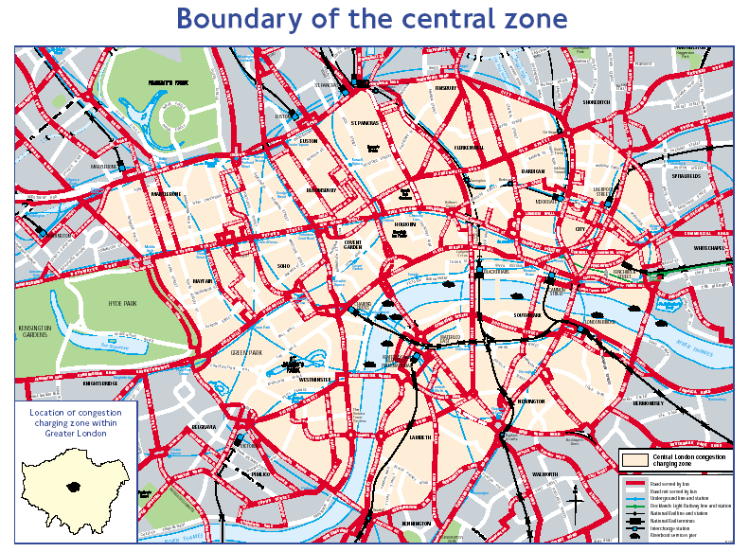
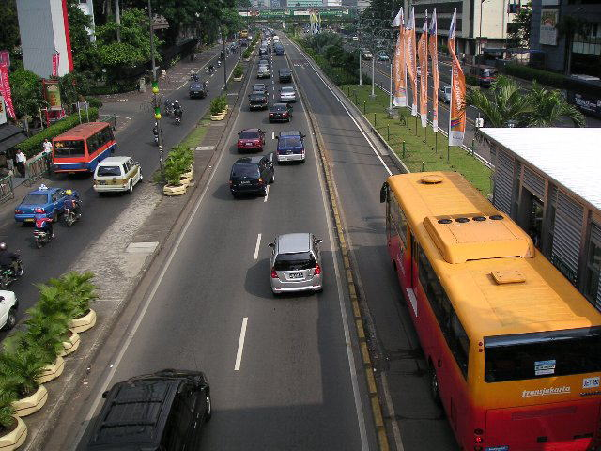
- Various Transportation Policies
Congestion Charging
(London, UK)
Light Rail Transit: LRT
(Strasburg, France)
Exclusive Bus lanes
(Jakarta, Indonesia)

Slide 7
→ Transportation systems should be planned with “Urban structure”, “Land Use”.
→ Appropriate, efficient and feasible modes are required.
→ Combinations, Connections & Coordinates between Different modes are also essential issue.
LRT/tram
Density [pass./Km]
MRT/subway
bus
walk
car
2 wheel
Trip Distance

Slide 8
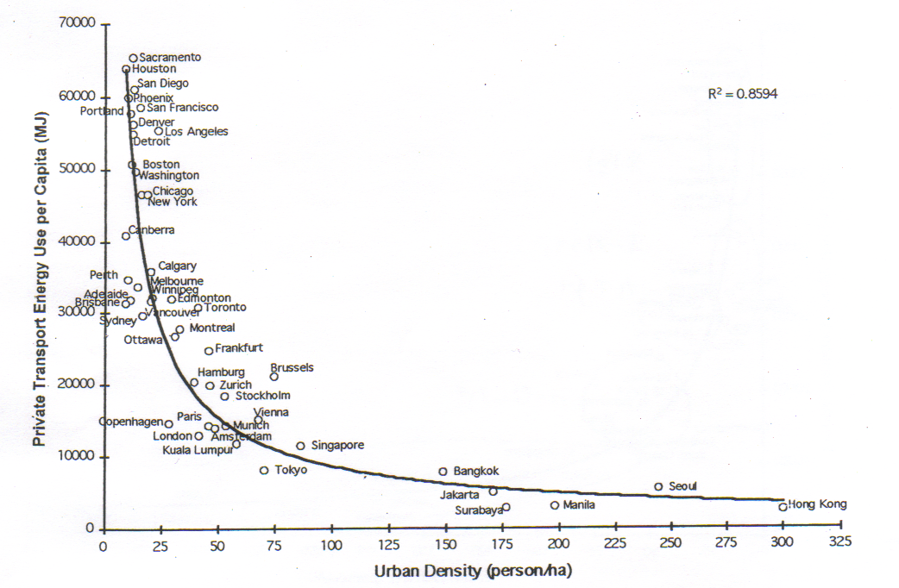

→ One of the important issues is “prospect of car”
→ “Urban structure”, “Economic growth”, “Urban density” determine car share → Car share changes people mobility & QOL But car oriented city may not be “sustainable”.
U.S.A.
Australia
Urban Spatial Structure and
Car Use for World Cities (1990)
Canada
Europe
Asia
Notes:
This energy use means the share of car.

Slide 9
Economic growth → car ownership → high growth of Vehicle Miles Traveled (VMT)
And…
High VMT requires more road capacity (total length & lanes) , huge road construction cost also requires economic growth
1980
1980
1985
1985
1980
1995
1995
1990
1985
1980
2000
2000
1990
2000
1995
- Bangkok has constructed roads which meet growth of car demand
- Manila failed ?
1980
1985
2000
1990
1995
2000

Slide 10
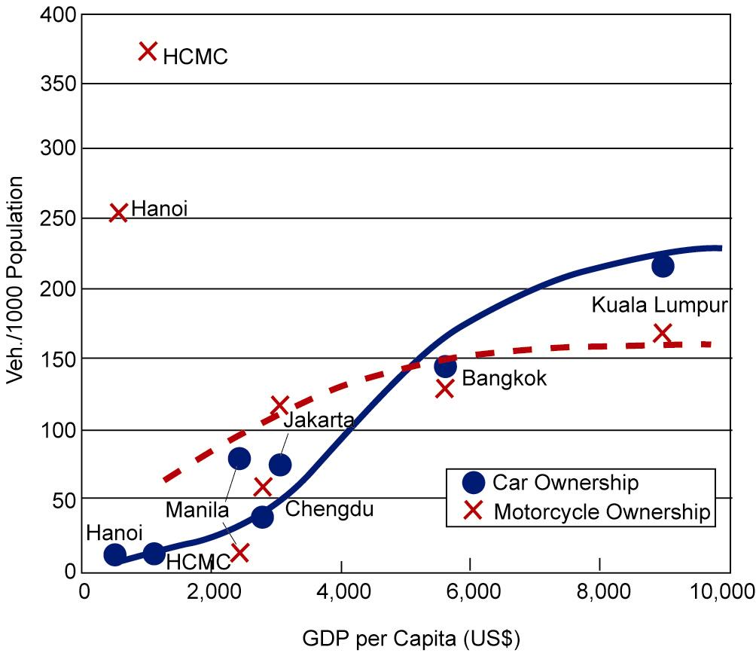
Relationship between Vehicle Ownership and GDP per Capita
Vehicle Ownership in Selected Asian Cities
 | Jakarta, Indonesia | Manila, Philippines | Bangkok, Thailand | Singapore | Hanoi, Vietnam | HCMC, Vietnam | Chengdu, China
Year | 1994 | 1996 | 1993 | 1993 | 1995 | 2002 | 2000
No. of Vehicles
- Motorcycles | 1,084 | 73 | 1,105 | 120 | 630 | 2,040
- Cars | 681 | 806 | 1,147 | 322 | 27 | 66
- Other 4weel-veh. | 487 | 142 | 291 | 142 | 60 | 92 | 166
No. per 1000 population
- Motorcycles | 118 | 8 | 136 | 41 | 254 | 377 | 134
- Cars | 74 | 85 | 142 | 110 | 11 | 12
- Other 4weel-veh. | 53 | 15 | 36 | 48 | 24 | 17
Population (mil.) | 9.2 | 9.5 | 8.1 | 2.9 | 2.5 | 5.4 | 54

Slide 11
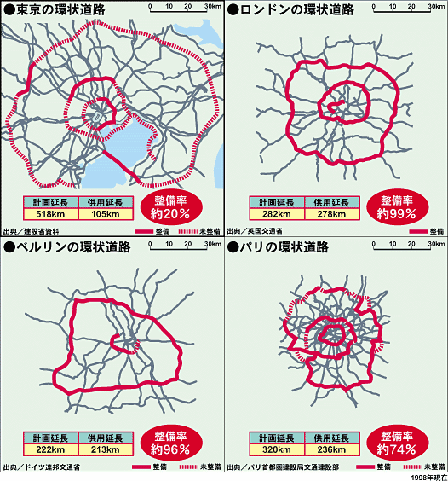
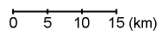
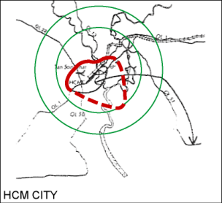
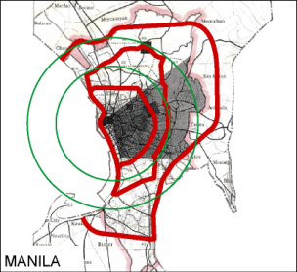
Tokyo
London
HCMC
Berlin
Paris
Manila

Slide 12
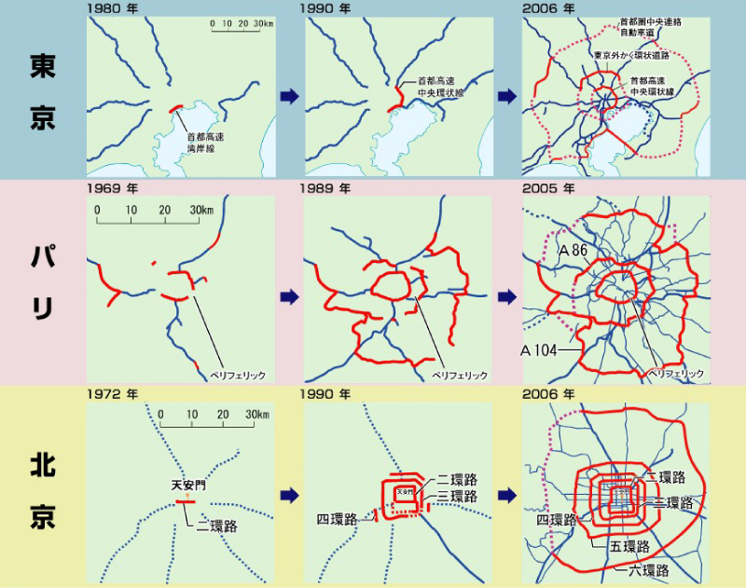
Tokyo
Paris
Beijing

Slide 13
Data Processing in Planning
Person Trip Survey
Data Check
Data Analysis
Present Situation
Model Building
Demand Forecasts Model
Simulation of Traffic Demand Forecasts
Traffic Demand Forecasts
Notes:
A transportation planning project is conducted according to the following steps:
(1) Trip surveys for investigating the flow of people and goods;
(2) Understanding of the present situation based on the above-stated surveys;
(3) Building of future traffic demand forecast models; and
(4) Forecasting future traffic demand by using various future forecasts as parameters.

Slide 14
2. Important Factors of Transportation Surveys
5 Factors for Better Transport Surveys
Travel Survey, Person Trip…
Trip
Road Width,
Size of Container…
GIS, Floor Area …
Space
Capacity
Performance
Volume
Travel Time, Length of Congestion
(LOS: Level of Service)
Traffic Count,
Revenue of Toll Road…
Notes:
1) Trip
This is an element to show the spatial flow rate of people or goods. This will be the most important
survey data for transportation planning. The results are consolidated as an OD Table.
2) Capacity
This shows the sizes (capacities) of transportation systems including width of road, capacity of railway cars
and the number of takeoffs and landings on airport runways are also important for establishing transportation planning.
These are conditions of the supplier side and affect planning of facility scale that matches demand.
3) Volume
This will be the data for understanding one spot traffic demand such as traffic volume at an intersection
and incoming/outgoing passengers at a station. This is useful for checking the OD Table or aggregated
traffic volume.
4) Performance
This is the data showing LOS (Level of Service) including time required, distance of traffic jam and cost
for movement. For example, this will be important when checking changes in user services that arise
according to facility planning. In recent years, evaluation on draft planning through Performance Measure is
being conducted mainly in the United States.
5) Space
This is the data that is mandatory for evaluation on alternate spatial draft for facility improvement
including land use, building location status and land price of the area where transportation facility
improvement is executed. In particular, land-use data is indispensable in the context of urban planning.
Due to development of GIS, disclosure of highly operational and economical data is being promoted in recent years.
A comprehensive survey in which these five factors are well-balanced will be required.

Slide 15
Trip:
Origin-Destination Table, Daily Travel …
Volume:
Traffic Volume at intersection, Station, Port…
Performance:
Travel Speed, Congestion Length…
Capacity:
Number of Lanes, Rail Car capacity, Depth of Berth…
Land Use:
Usage of Land, Distribution of Population, GIS data…

Slide 16
Input data for transport demand model
Production: Population (nationwide), Economic variables
Generation, Attraction: Population, Socio-economic variables
Distribution: spatial map data
Modal Split: Transport Level of Service (LOS) data
Assignment: Attributes of Road (Capacity, # of lanes etc.)
Trip
Space
Capacity
Performance
Volume

Slide 17
3. Actual Trip Surveys
(Passenger & Goods Flow)
1) Trip
From “Origin” to “Destination”
→ OD Table is the most important set of statistics for transport plans
Questionnaire Survey should be required
→ traffic count data does not give OD information
A “Person Trip Survey” or “Household Interview Survey” or “Commodity Flow Survey” should be conducted
Notes:
i) Trip Survey
This is data concerning movement from the departure place to the arrival place and will be
the most important statistical data in transportation planning. Since a mere counting survey
does not identify OD, a passenger survey and a goods flow survey both require statements
on movement through a questionnaire survey. Regarding passengers, the survey is called
the Person Trip (PT) Survey or the Household Interview Survey (HIS).
A questionnaire survey is conducted in metropolitan areas with an extraction rate of a few percent.
Regarding goods flow, the survey is called the Commodity Flow Survey, and in many cases,
questionnaire surveys are conducted to business owners.

Slide 18
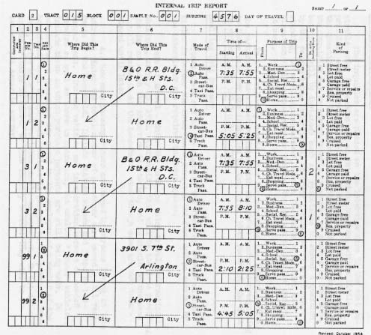
Conventional Travel Survey Sheet (1950’s in the U.S.A.)
Notes:
The HIS survey system was established in the 1950s in the United States. Along with the survey system,
the 4-step model which is a typical traffic demand forecast method was also developed. The following figure
shows the questionnaire sheet used at that time, and the destination of movement, purpose, time,
transportation mode, etc. of the movement were stated for each trip. It should be noted that a trip
when referred to in terms of transportation planning shows a unit for moving from the departure place
to the arrival place to achieve a certain trip purpose. Trip in a city, the typical purposes can be divided
into “commuting/going to school”, “business”, “shopping/private affairs” and “going home.” While for inter-city
transportation, classifications of “business”, “leisure”, “homecoming”, etc. are frequently used.

Slide 19
＜Japan – Year 2000＞

Slide 20

Example of “the 4th Tokyo Person Trip Survey”
1st in 1968
2nd in 1978
3rd in 1988
4th in 1998
5th in 2008
Region | Population | Number of | Number of
 |  | Delivered | Collected
Ibaraki pref. | 1,544,760 | 51,933 | 42,828
Saitama pref. | 6,893,102 | 242,340 | 189,487
Chiba pref. | 5,006,952 | 168,853 | 140,533
Tokyo | 11,850,311 | 388,518 | 258,873
Kanagawa pref. | 3,764,503 | 152,610 | 102,432
Yokohama city | 3,346,785 | 148,242 | 91,585
Kawasaki city | 1,207,985 | 52,037 | 33,292
Chiba city | 856,977 | 31,251 | 24,014
TOTAL | 34,471,375 | 1,235,769 | 883,044
Sampling rate: 2.6%

Slide 21
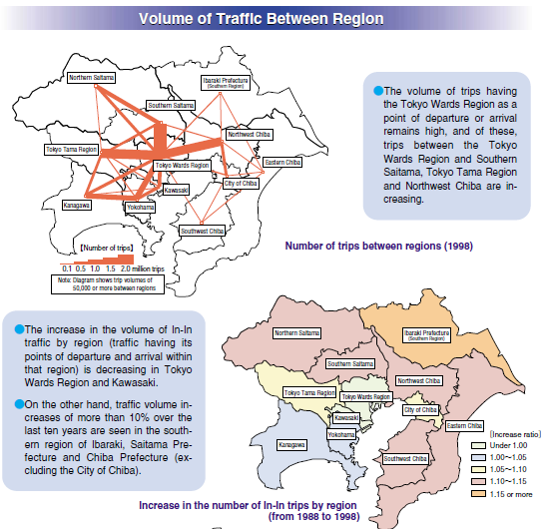
Conventional results…
It may clarify the current situations.
However, only few people might image the situation and feel the transportation issues.

Slide 22
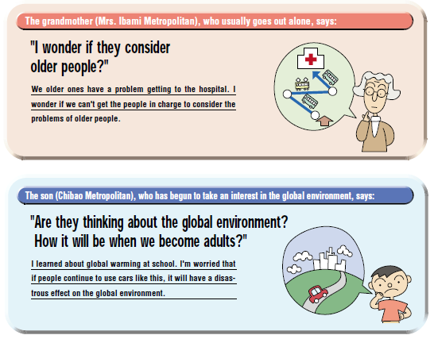
Much effort for obtaining better understanding of public are required
Example of “Tokyo PT 1998”, friendly characters raised the urban transportation problems.

Slide 23
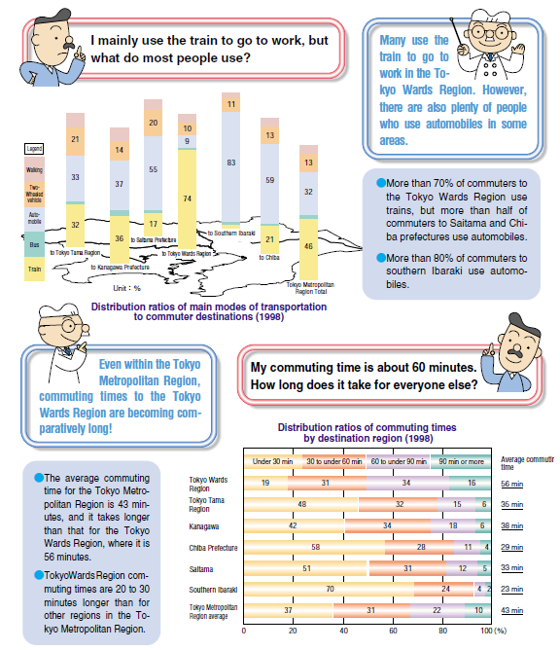
“Q & A” by using results and characters dialogue
Other chances for Public
- Public Hearing
- Open House
- Public Meeting
- Festival for M/P
- Public Advertising
are useful ways for
Public Involvement, Public Participation

Slide 24
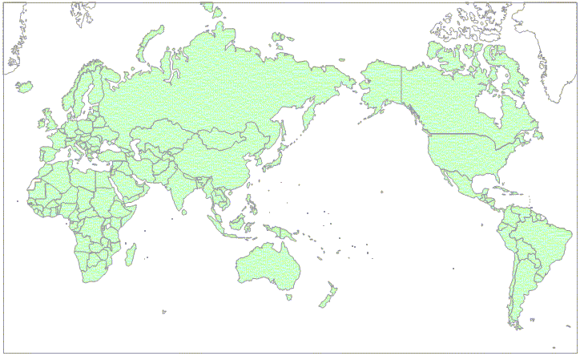
8.Bucharest
18.Ulaanbaatar
3.Damascus
20.Kabul
5.Chengdu
19.Dhaka
1.Tripoli
21.Lahore
13.Hanoi
7.Belem
9.Cairo
25.Karachi
4.Manila
6.Managua
2, 24.PhnomPenh
17.DaNang
14, 22.Nairobi
11.KualaLumpur
12.HoChiMinh
15.Lima
16.DarEsSalaam
10.Jakarta
23.Maputo

Slide 25
Major transport surveys in Japan & U.S.A.
Name of survey area mode unit sampling cost
rate mill.$
Person Trip survey city all person 3-7% 5-20
Road OD survey nation car vehicle 3% 40
Commodity survey nation all freight 3% - - -
Metropolitan transit city transit person 12% - - -
Inter-city passenger nation all person - - - - - -
Person Trip survey city all person 0.4% 1
American Travel nation all person 0.1% 14
Survey
NPTS city all person 0.05% 7
Commodity Flow nation all freight 20% - - -
Survey
JAPAN
USA
Notes:
This is a list of transport surveys which is used to understand typical trips in Japan and the United States
is shown below.
In Japan, PT surveys in urban areas are conducted for metropolitan areas once every 10 years in the order
that the extraction rate is a few percent. In addition, road OD surveys in units of vehicles where the population
consists of fleet cars are also conducted once for every four or five years. Goods flow surveys among cities
throughout the nation have been conducted once every five years since 1970. The survey configuration is
almost the same as a commodity flow survey in the United States.
In the United States, large-scale urban area PT surveys were frequently conducted up until the 1970s as was
the case with Japan. However, after the 1980s, the scale of surveys has been reduced. This is because that
simple trip surveys, which are sampling surveys, are being conducted nationwide as incidental surveys to the
national census.
In addition, PT surveys are frequently conducted for urban transportation development surveys in developing countries.
JICA has been implementing PT surveys in a total of 50 or more cities to date since about the middle of the 1960s.

Slide 26
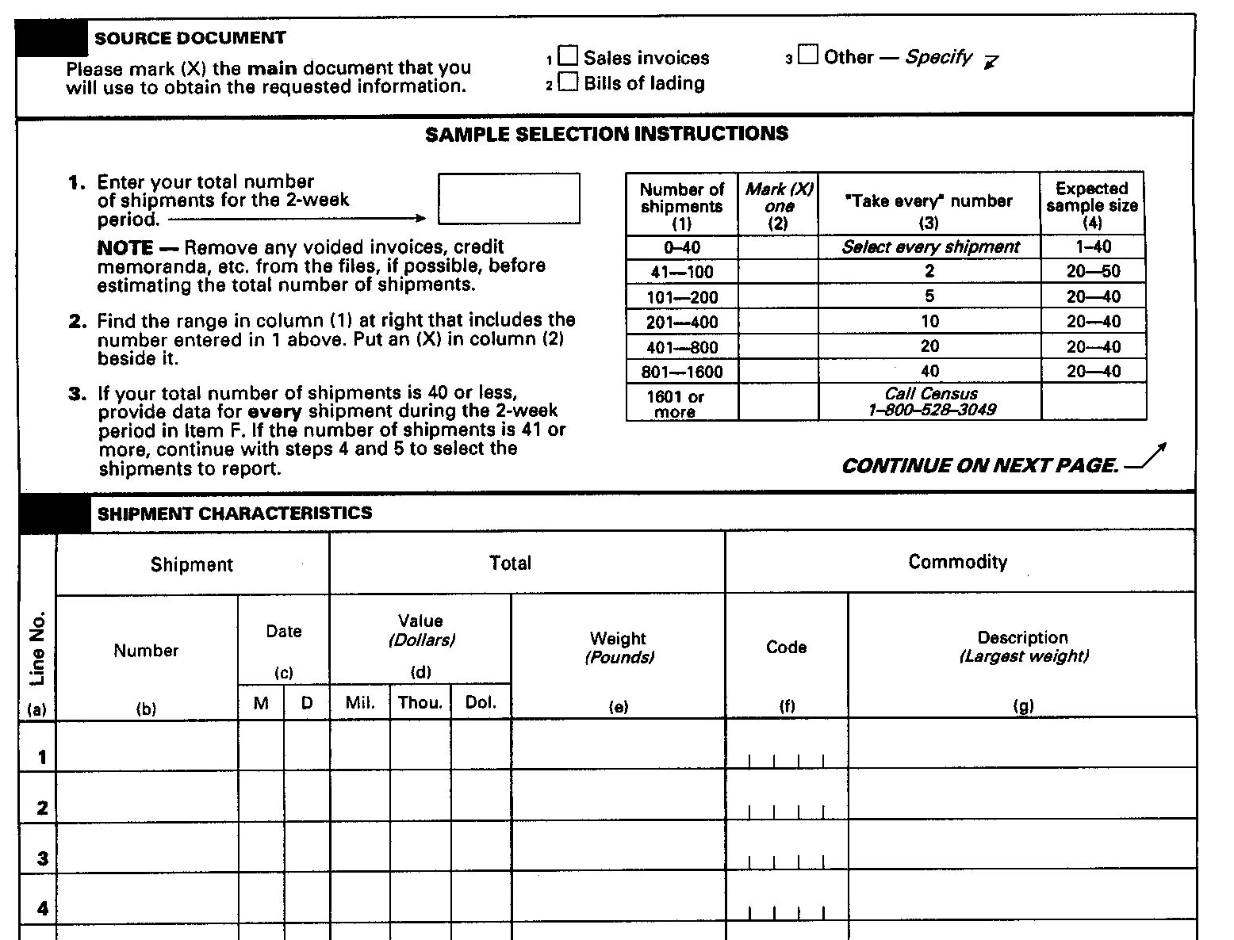
Survey sheet
Commodity Flow Survey (U.S.A.) in 1993
Notes:
On the other hand, the goods flow survey has difficulties that are different from a passenger survey.
For example, freight has different units (ton, cubic volume, pieces, pallets, etc.), and the shape
and the number of pieces vary significantly in the process of movement. Therefore, it is difficult
to define units. Usually, like the Survey Sheet used in the United States shown below, firms are
frequently requested to state the weight and the value. However, there are problems when a carrier
does not sufficiently understand the content of a container, or that a carrier does not have information
on true departure and arrival places of freight in a container, even though the carrier understands flow
among transshipment facilities.

Slide 27
Commodity Flow Survey in the US
- Almost same survey as Japanese CFS
- Conducted every 5 years, the latest one is 2002 CFS
- Sampled establishments: 51,000 (parent: 760,000)
Surveyed Industries
212 Mining (Except Oil and Gas)
311 Food Manufacturing
312 Beverage and Tobacco Product Manufacturing
313 Textile Mills
314 Textile Product Mills
315 Apparel Manufacturing
316 Leather and related Product Manufacturing
321 Wood Product Manufacturing
322 Paper Manufacturing
323 Printing and Related Support Activities
324 Petroleum and Coal Products Manufacturing
325 Chemical Manufacturing
326 Plastics and Rubber Products Manufacturing
327 Nonmetallic Mineral Product Manufacturing
331 Primary Metal Manufacturing
332 Fabricated Metal Product Manufacturing
333 Machinery Manufacturing
334 Computer and Electronic Product Manufacturing
335 Electrical Equipment, Appliances and Component Manufacturing
336 Transportation Equipment Manufacturing
337 Furniture and Related Product Manufacturing
339 Miscellaneous Manufacturing
421 Wholesale Trade, Durable Goods
422 Wholesale Trade, Nondurable Goods
4541 Electronic Shopping and Mail-Order Houses
493100 Warehousing and Storage
551114 Corporate, Subsidiary and Regional Managing Offices
Details are available at
http://www.bts.gov/ntda/cfs/index.html

Slide 28
Commodity Flow Survey Sheet in Tokyo

Slide 29
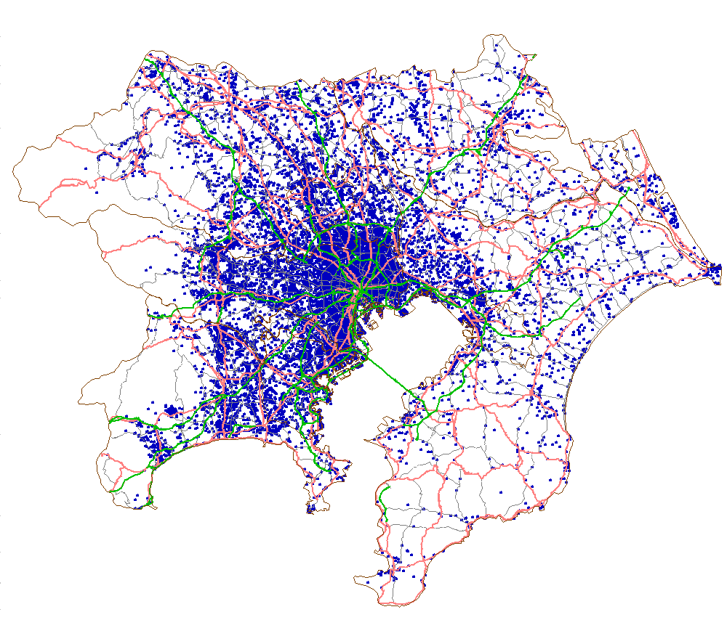
Total: 30,000 answers in 2004 survey
Notes:
○これは今回の調査でご回答いただいた約3万の事業所のサンプル。
○東京の臨海部を中心に東京都市圏全域に分布。
○個々の点ごとに、先ほど説明した調査項目についてのデータが把握されています。

Slide 30
Generation/Attraction Volume of Goods
Goods Flow Occurrence Concentrated Volume/total area (t/km2)

Slide 31
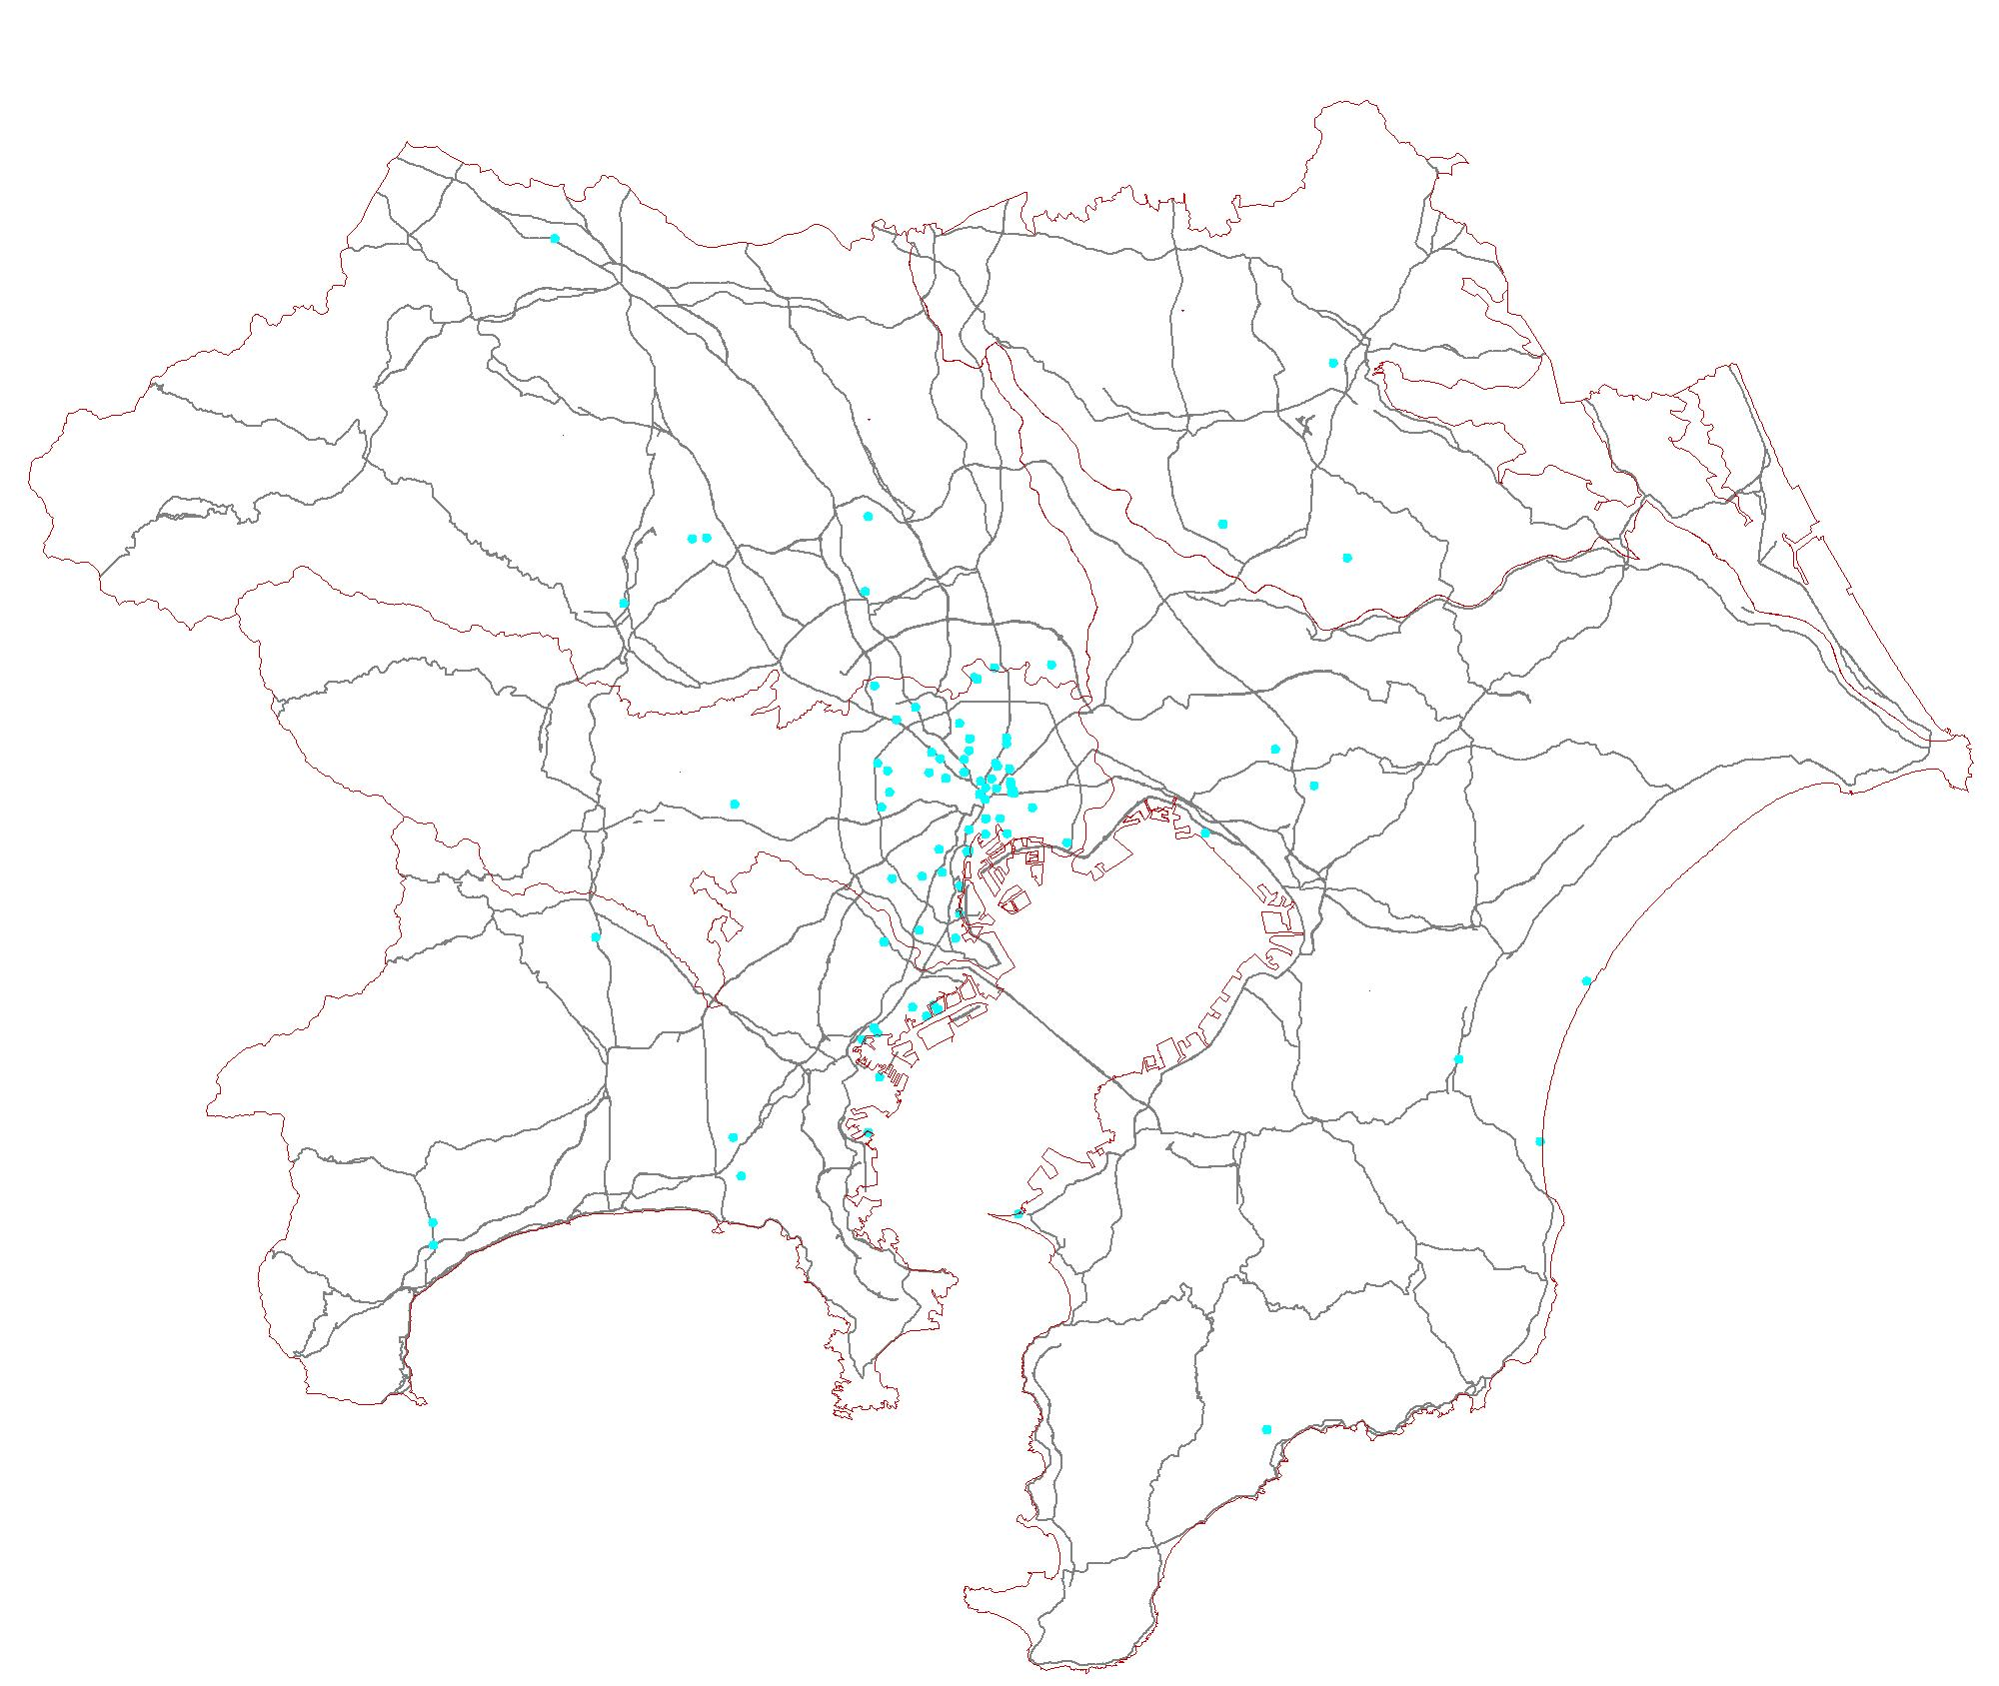
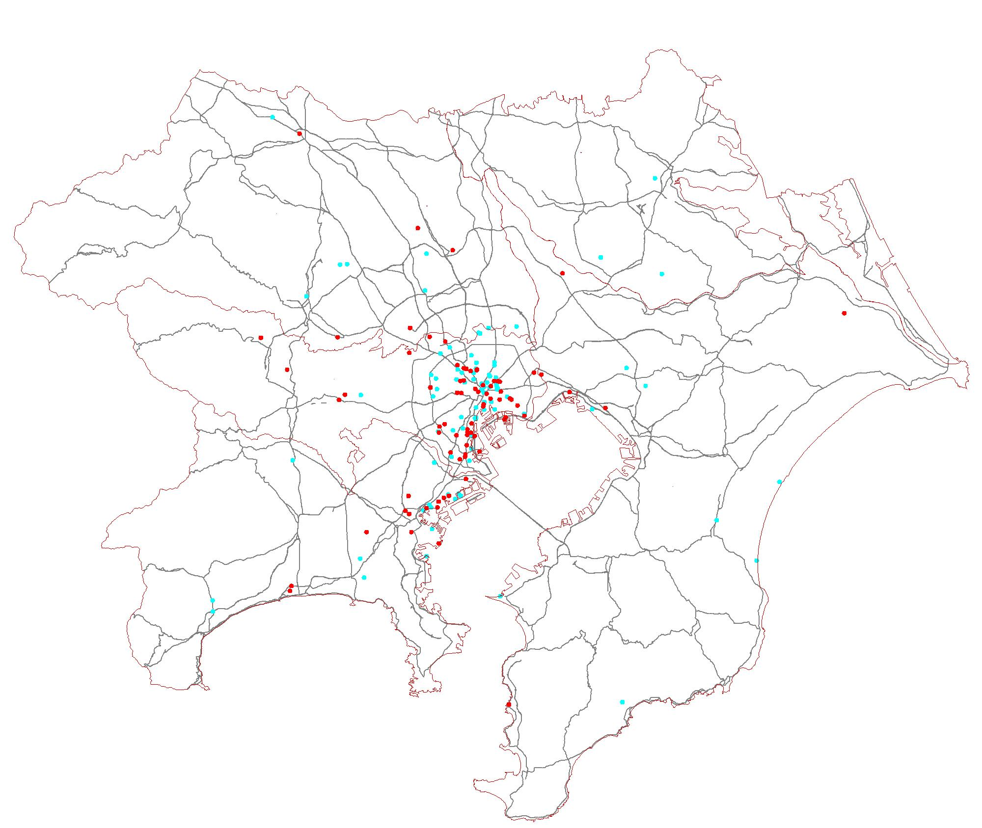
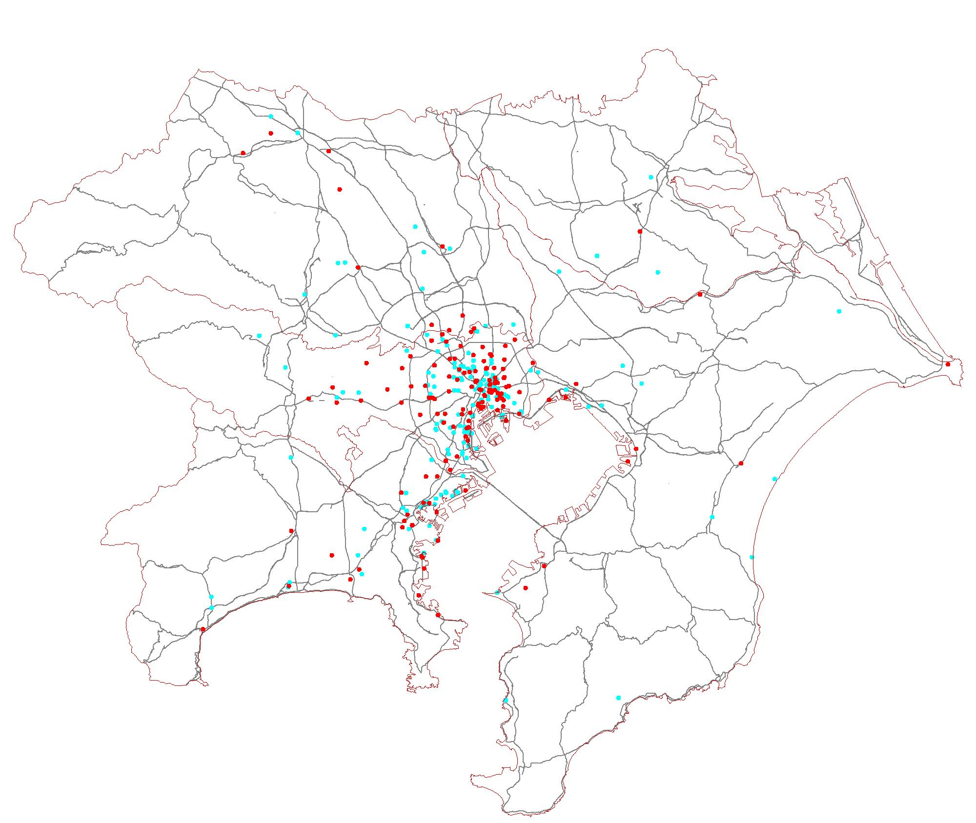
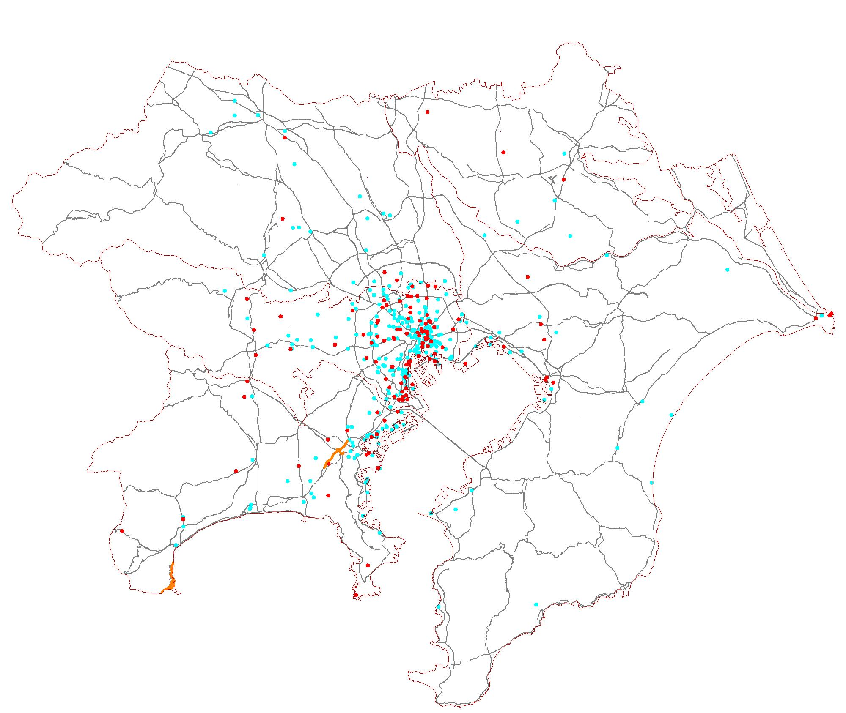
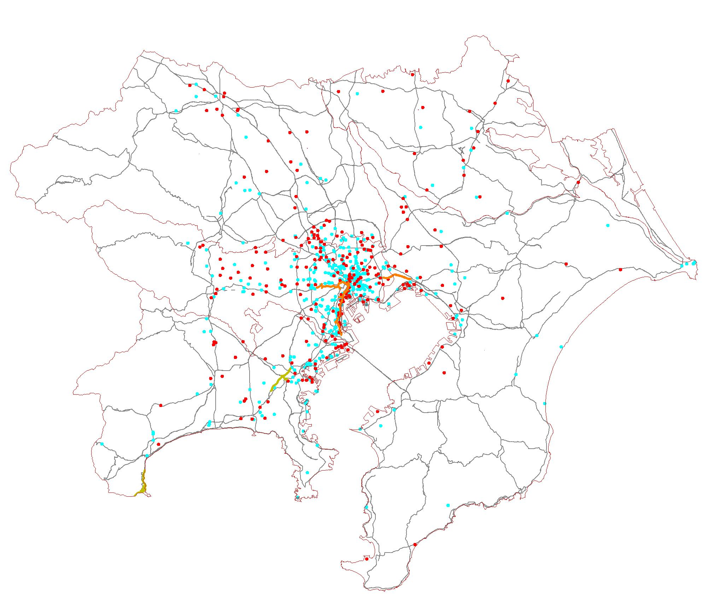
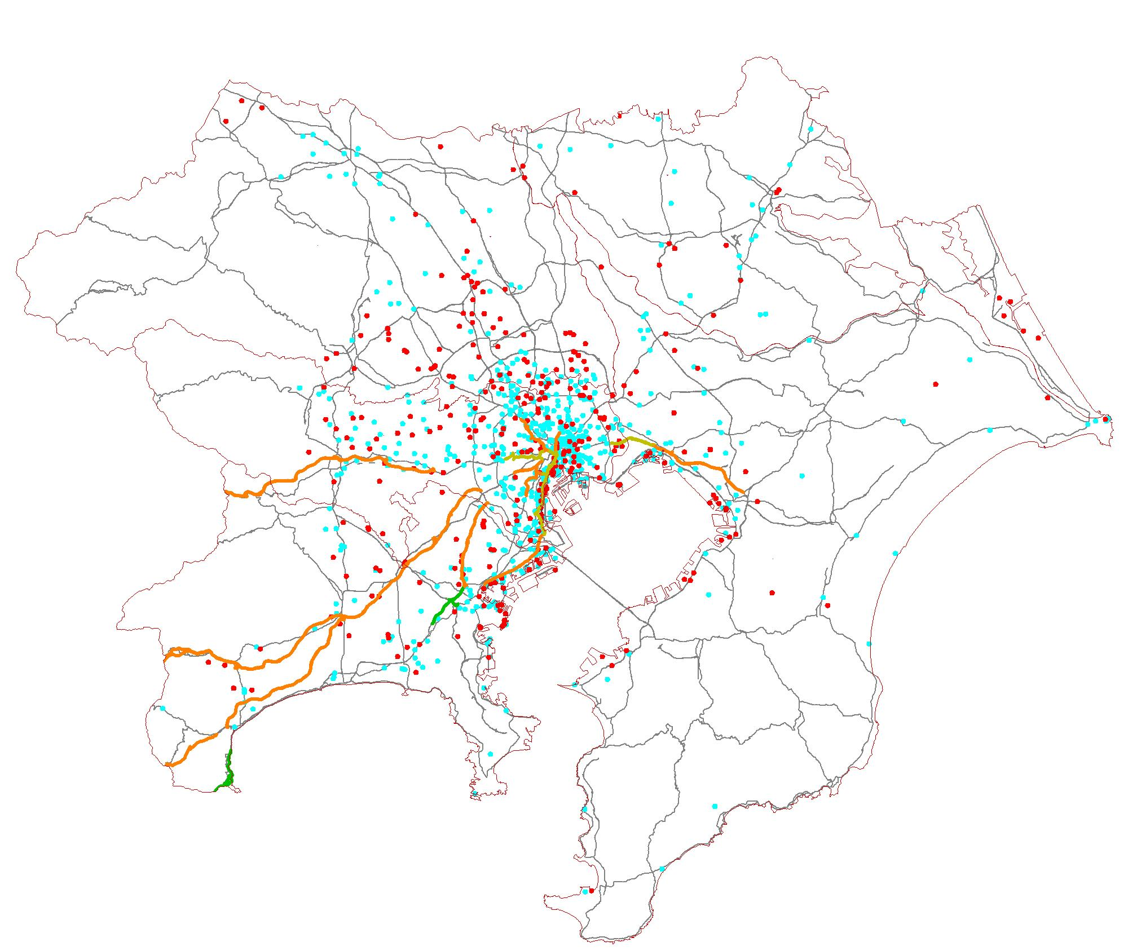
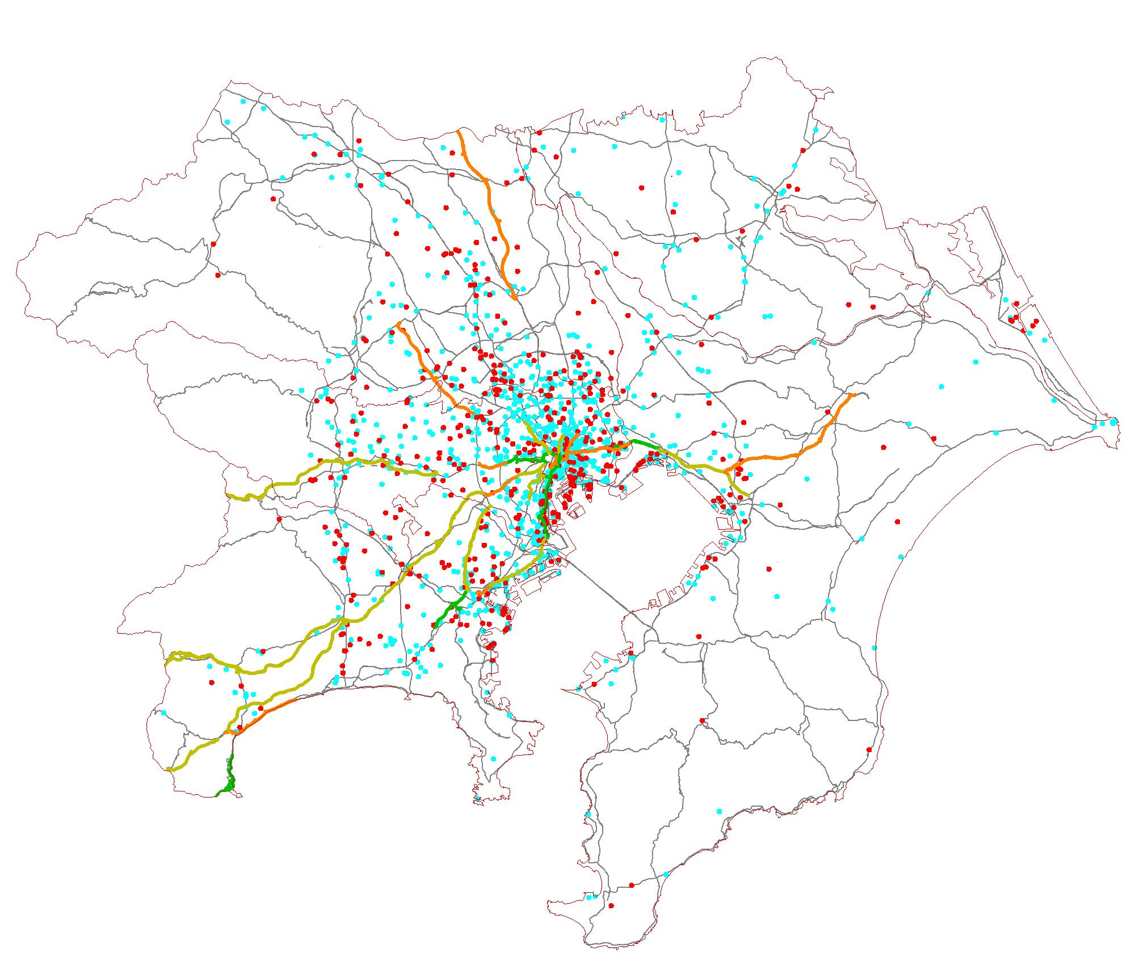
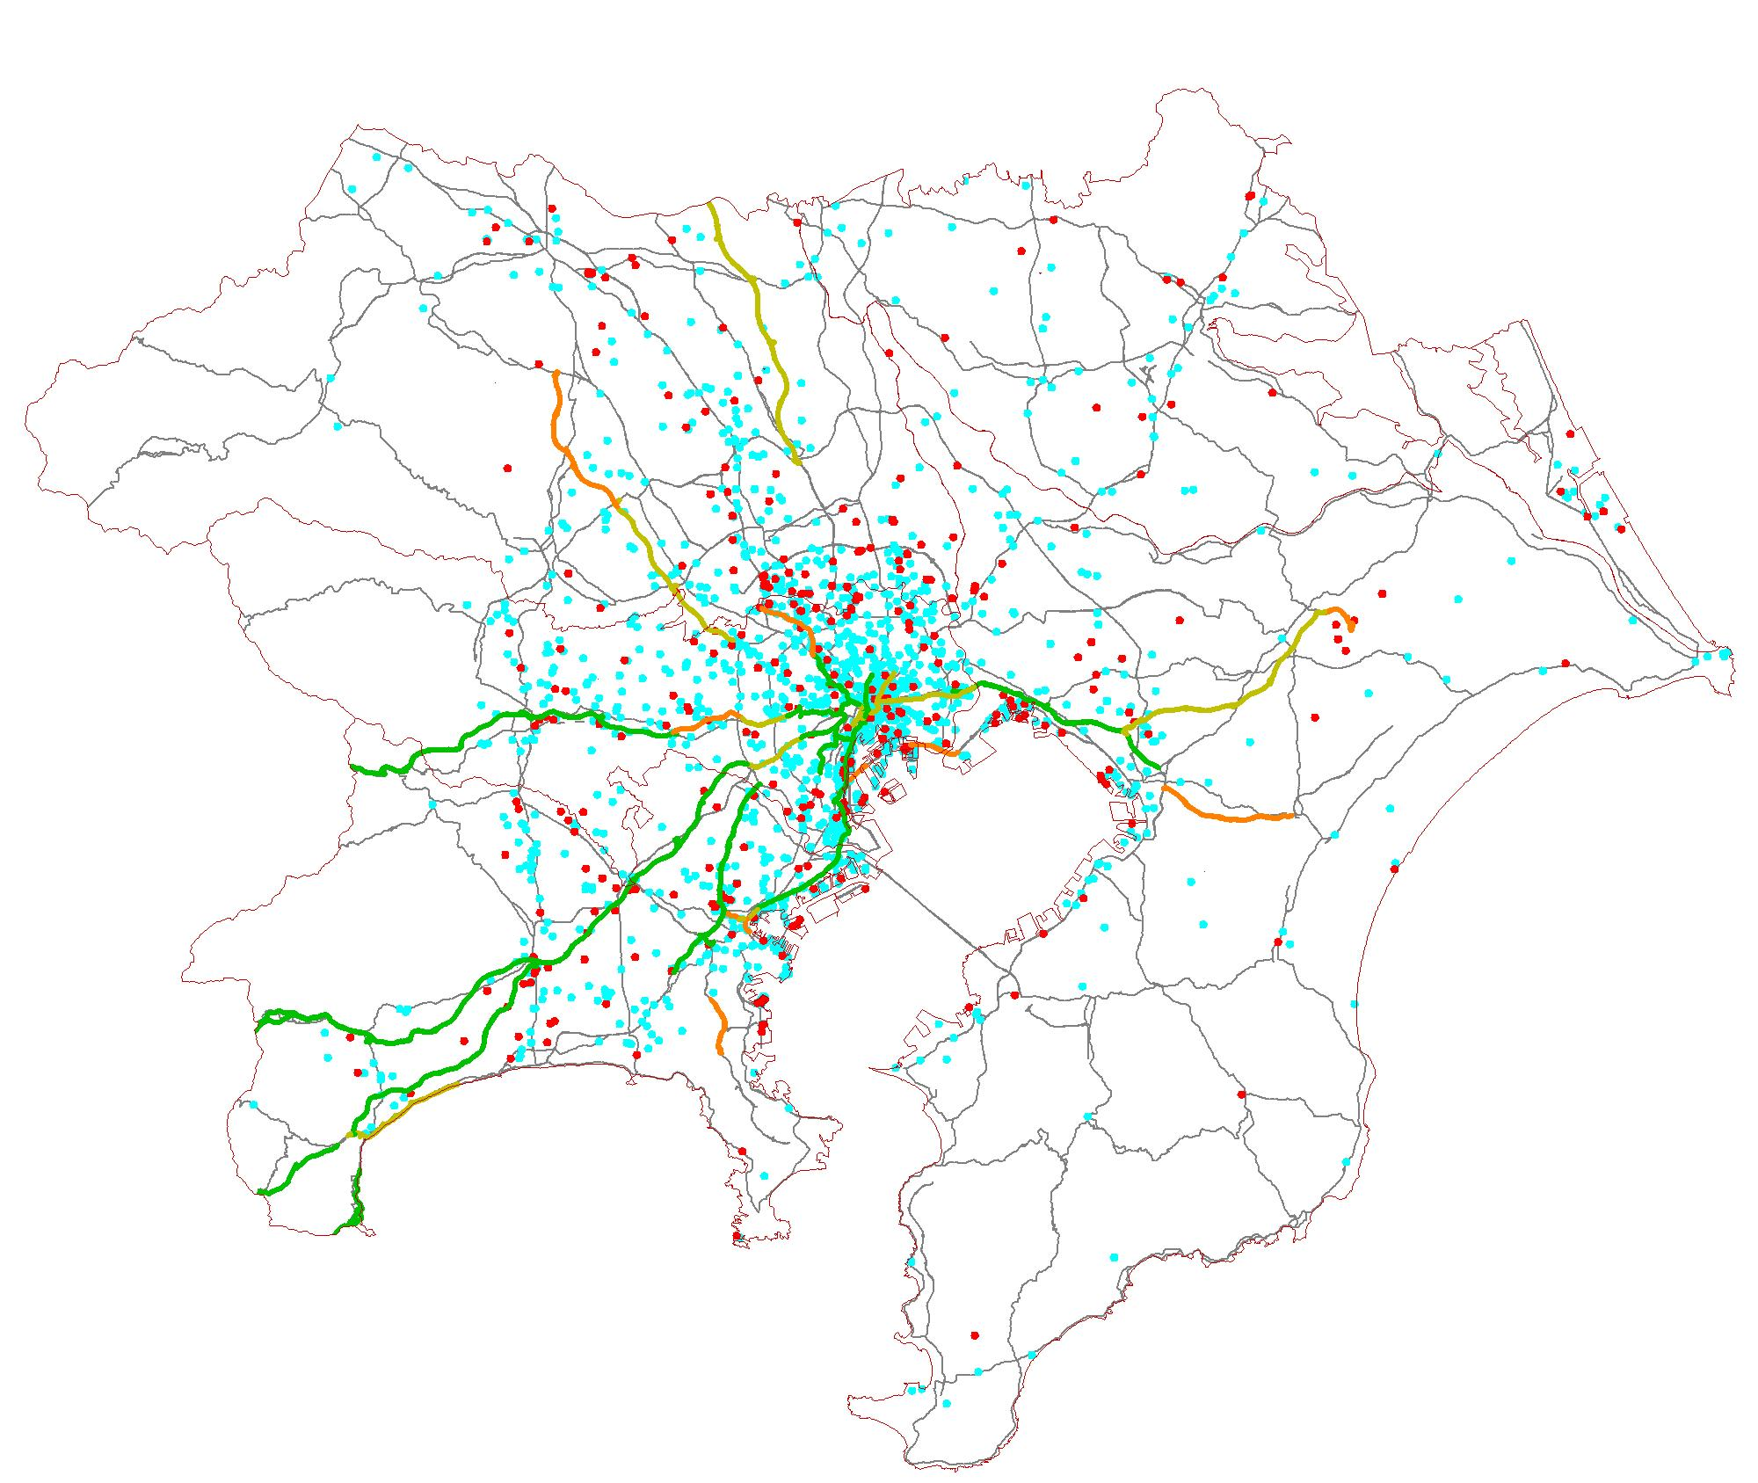
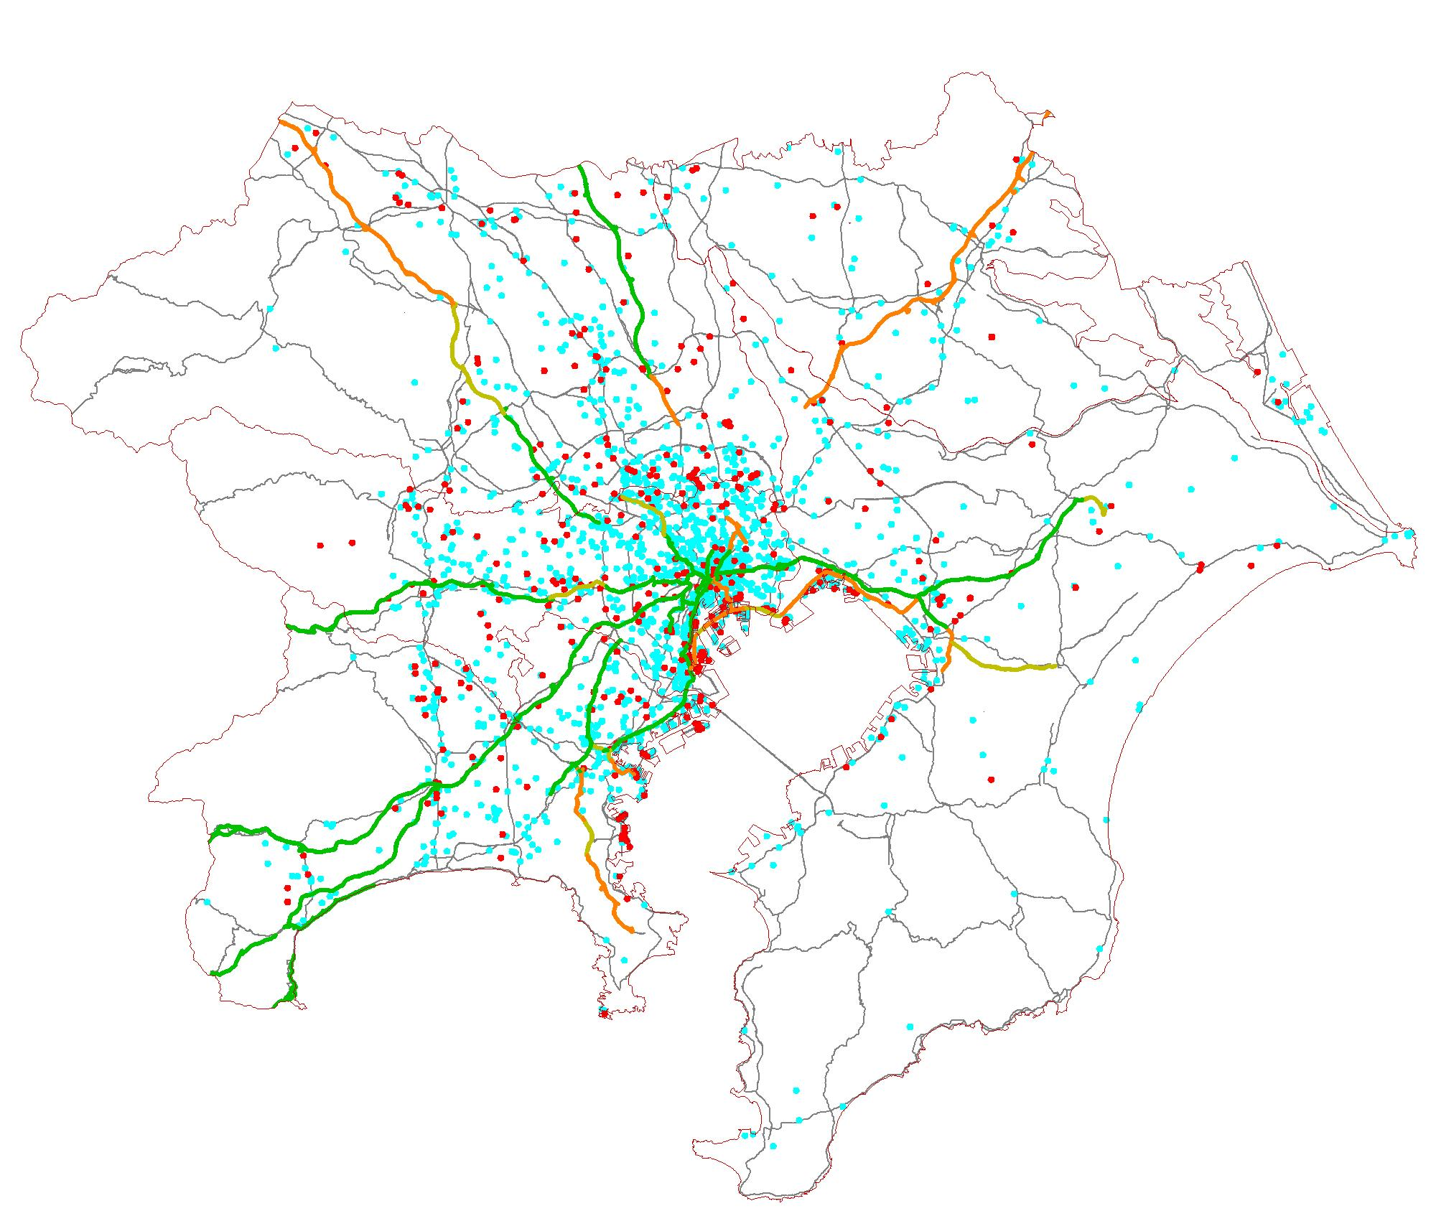
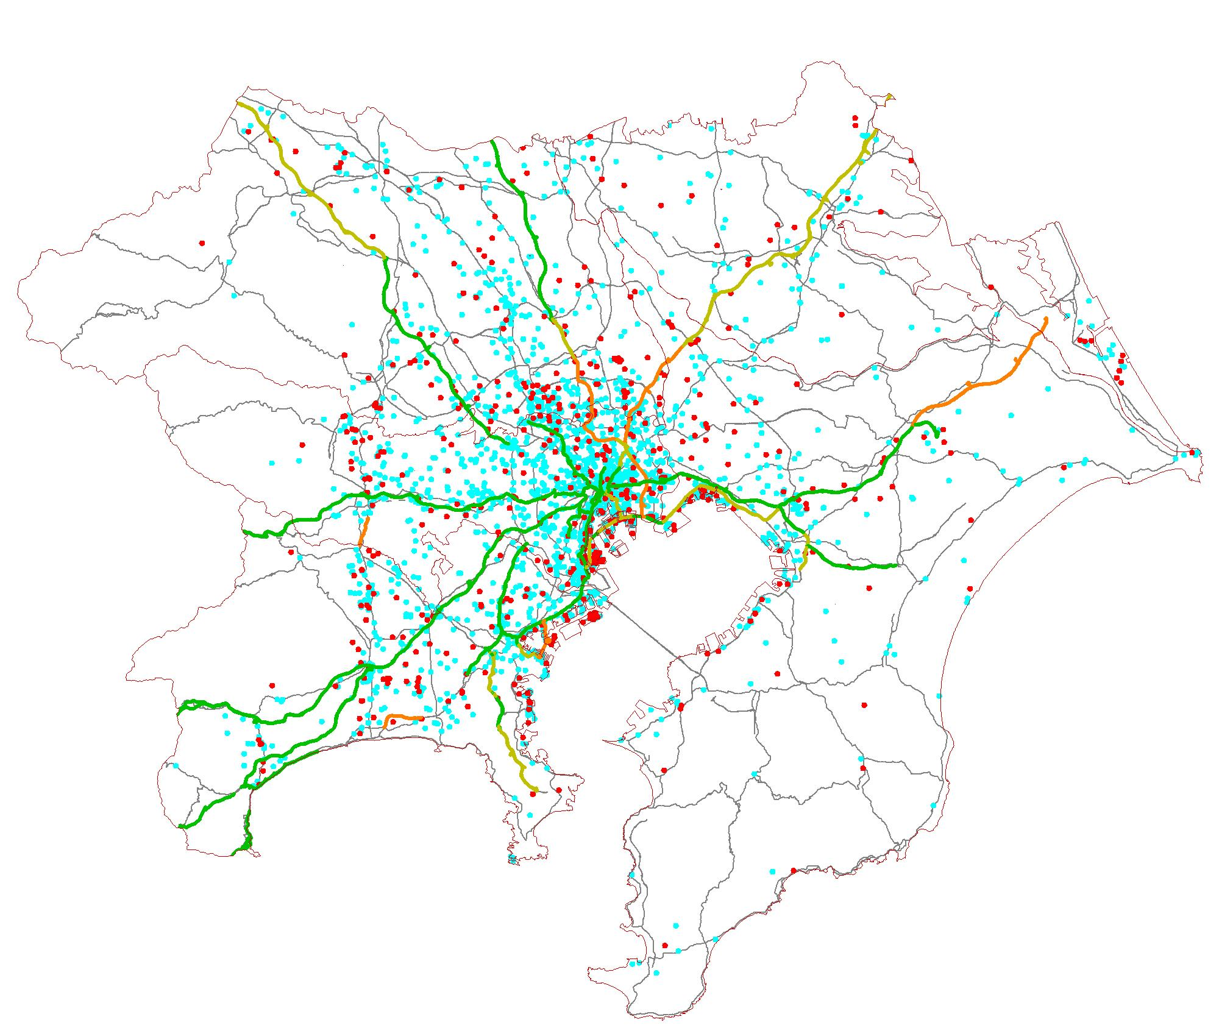
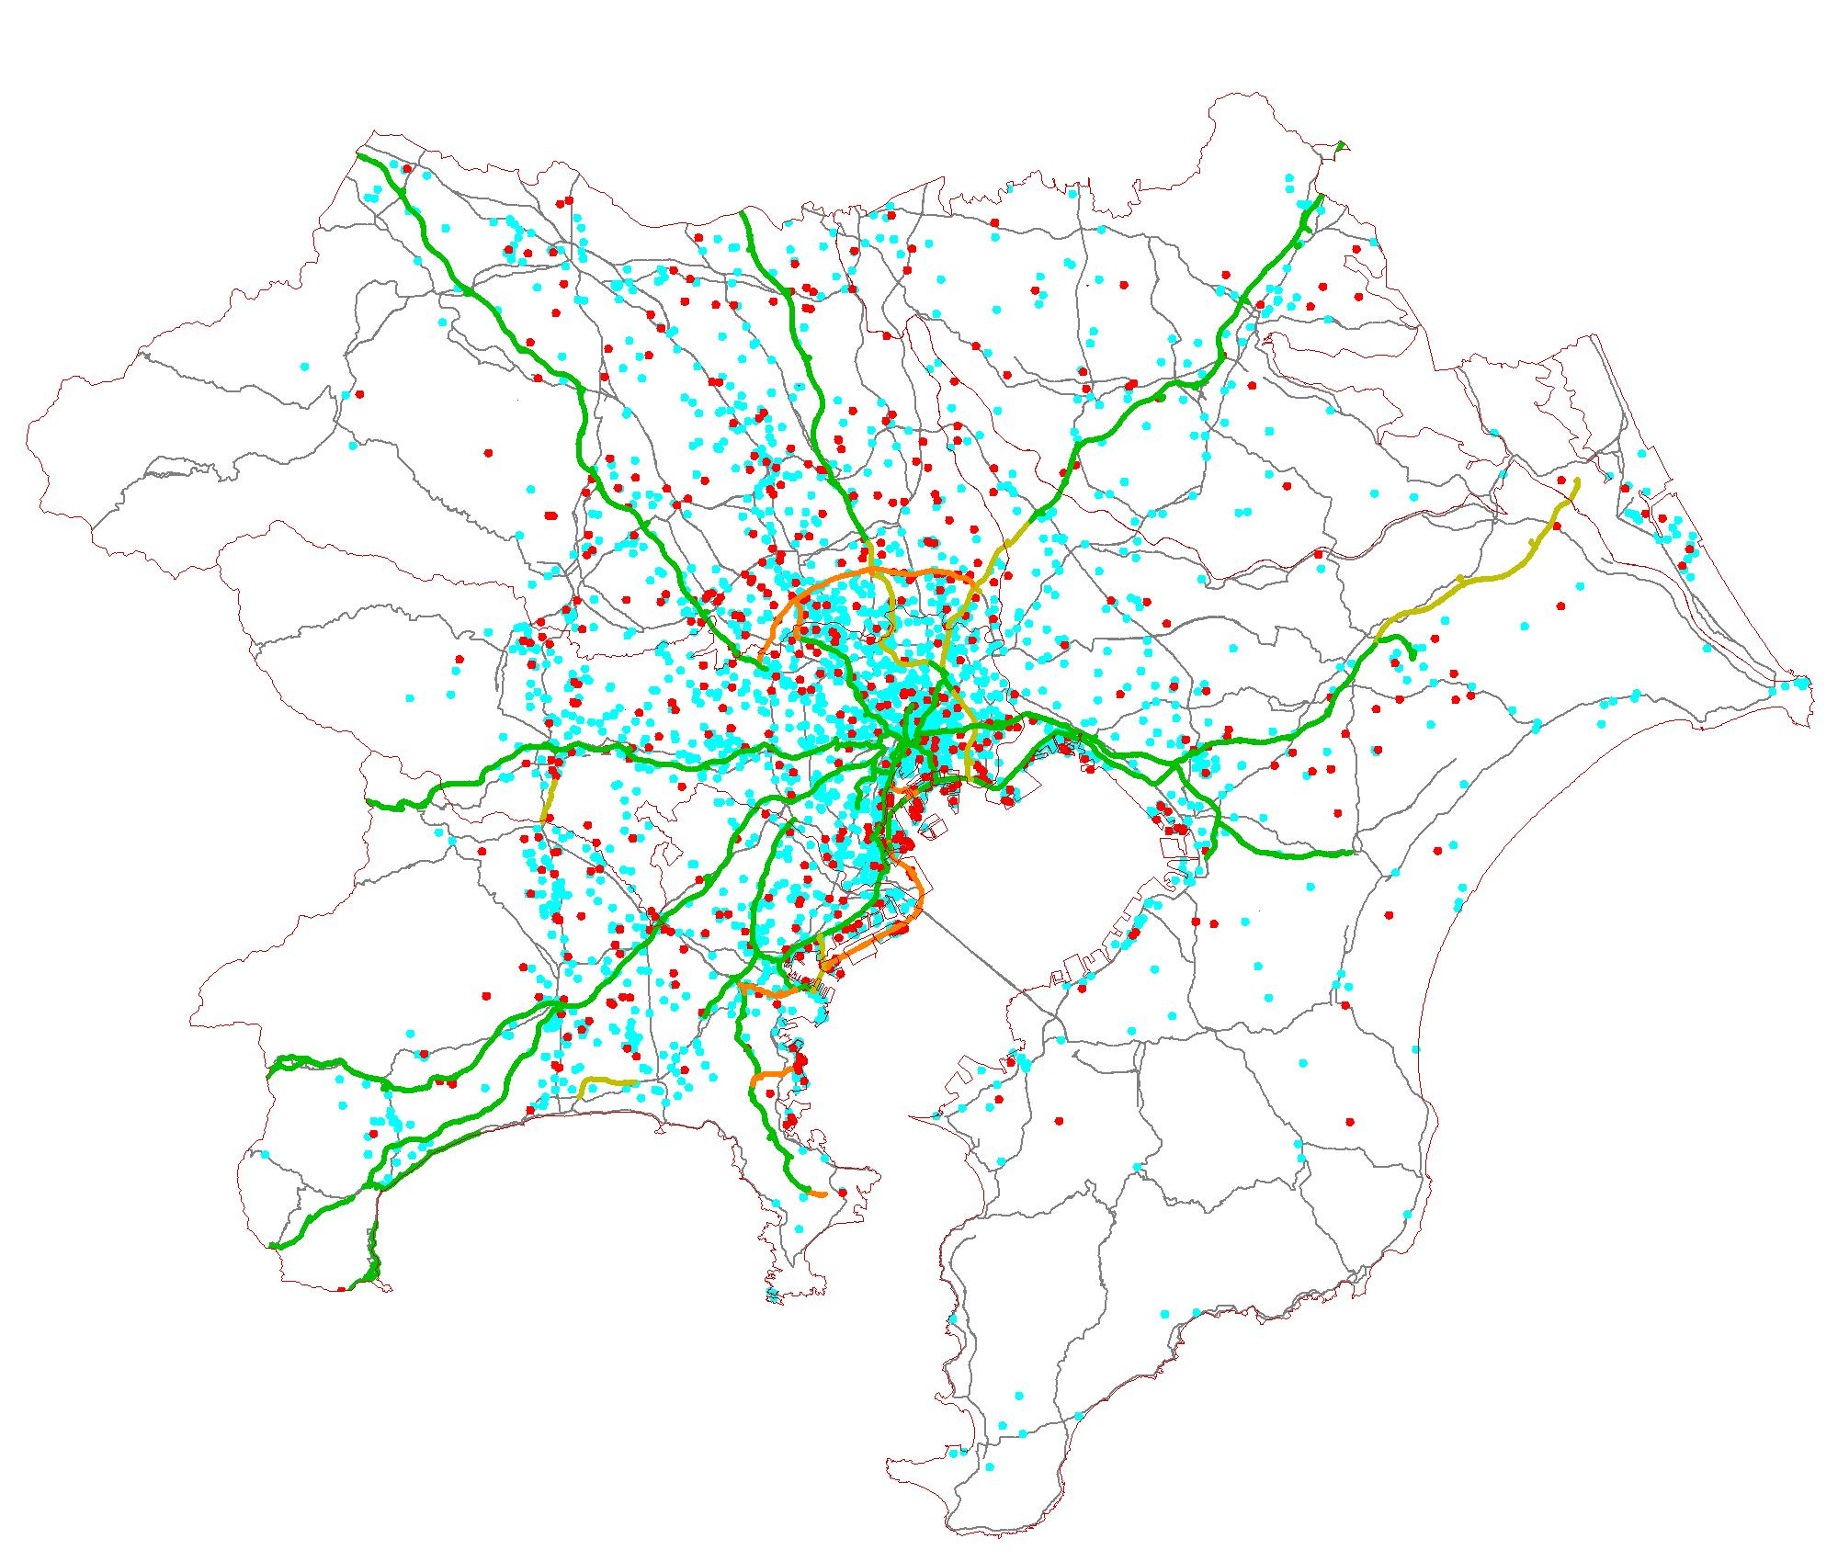
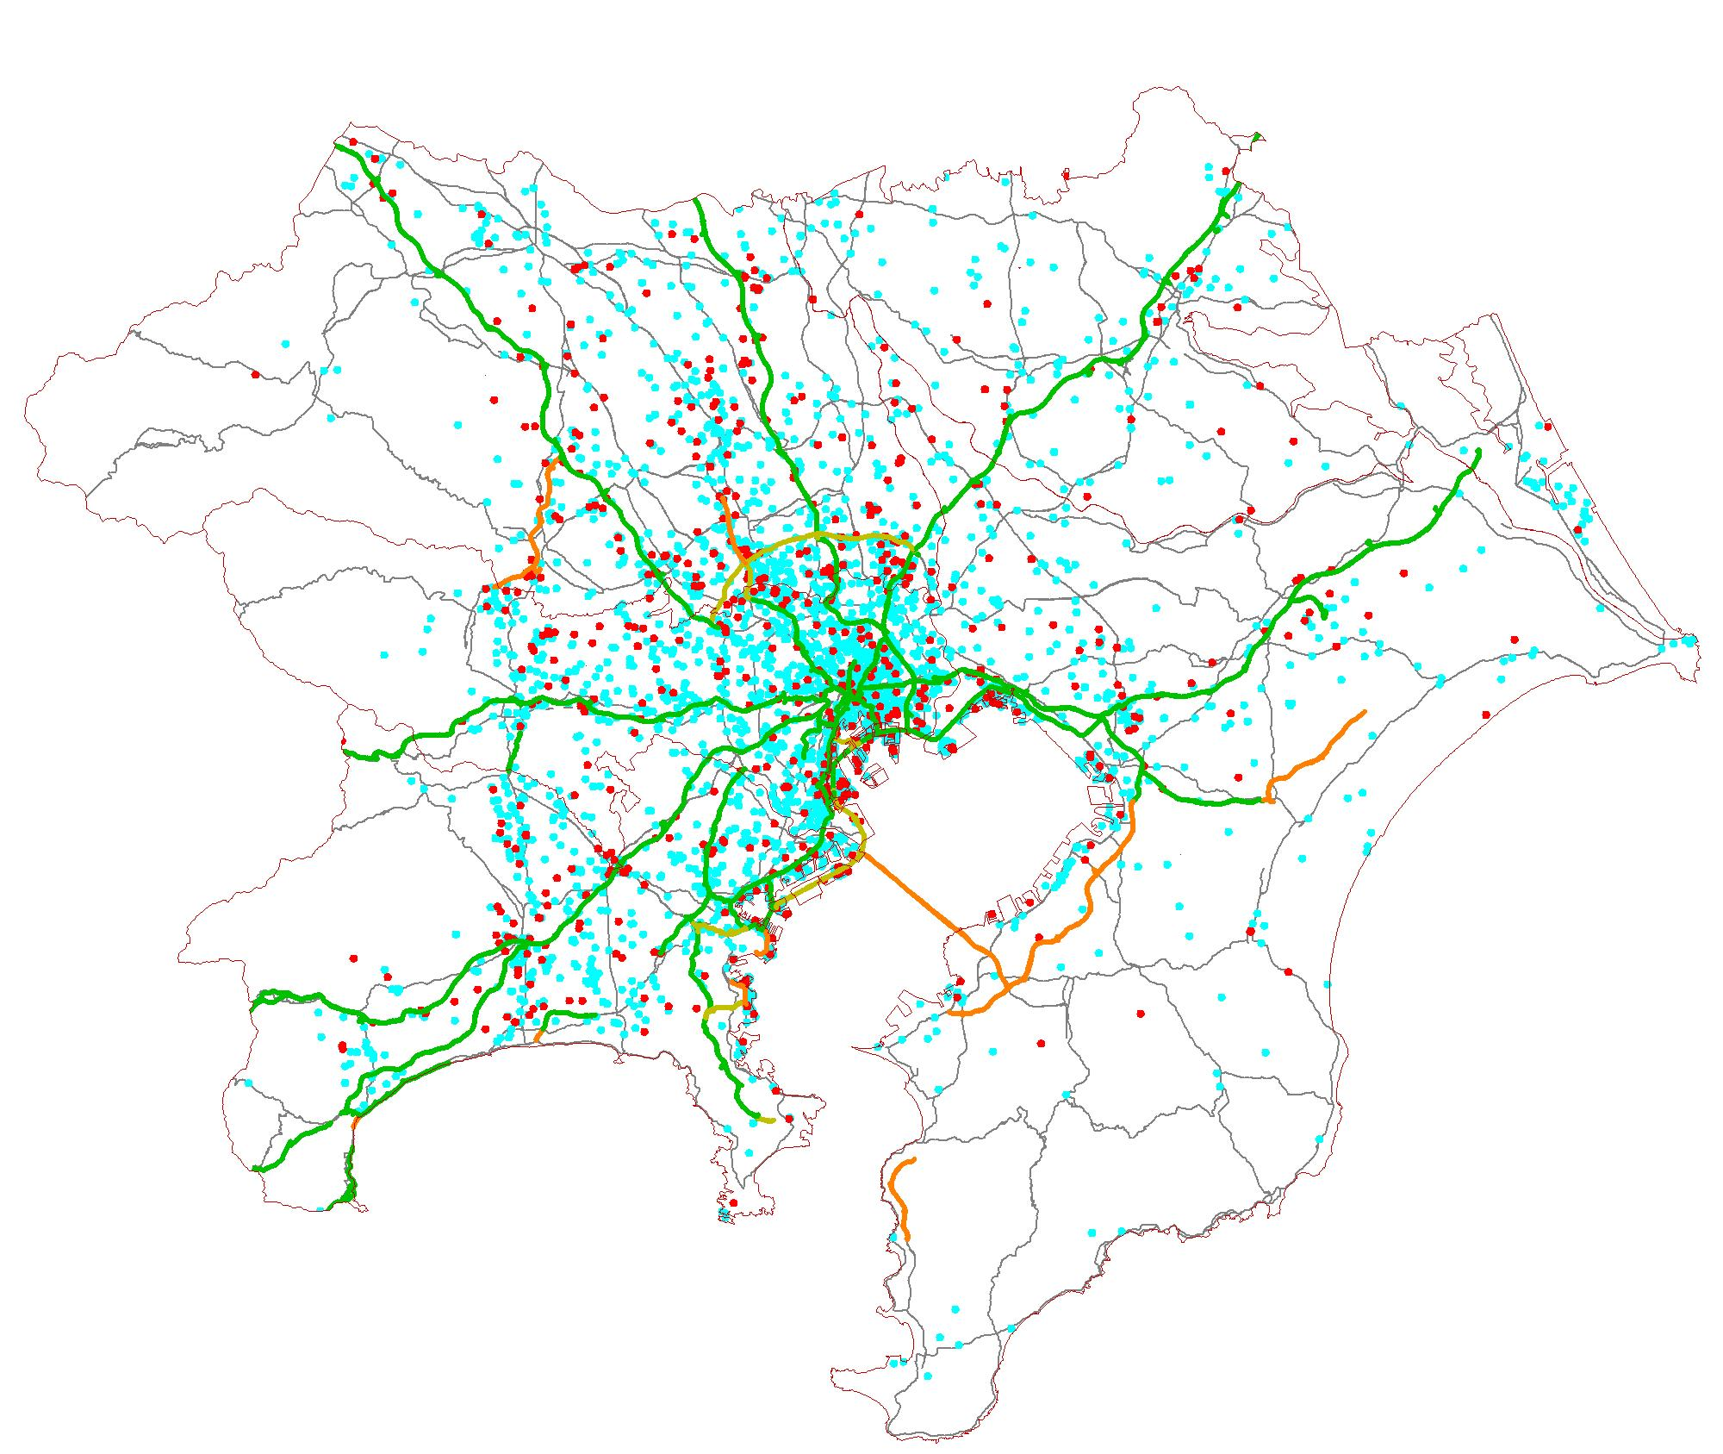
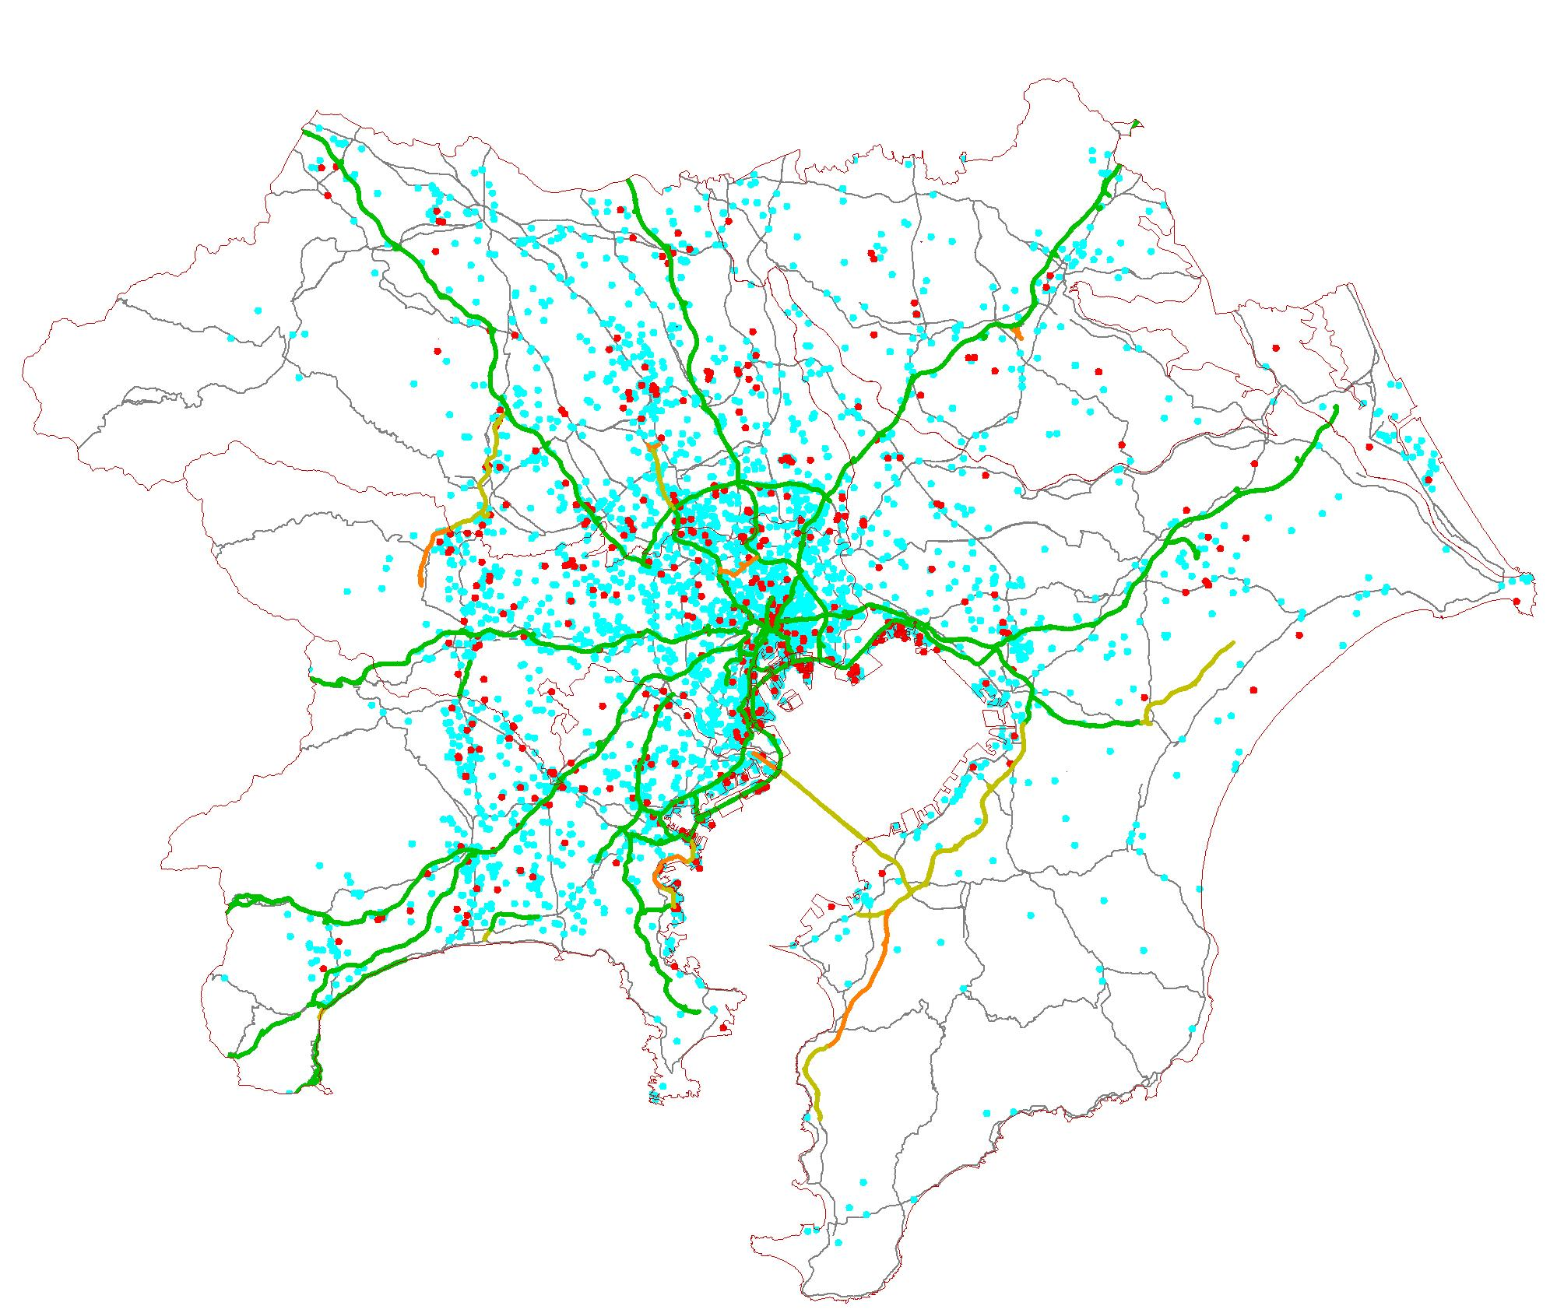
圏央道沿道への
立地が進んでいる。
臨海部に加え、新たに整備された高速道路沿道への立地も多い。
1959年以前は、物流施設の都心への立地が多い。
物流施設
高速道路
当該年代に整備
過去に整備

Slide 32
2) Capacity
V
Capacity of Road (QV curve)
Q : volume [ cars / hour ]
V : velocity [ Km / hour ]
K : density [ cars / Km ]
Q = K V (theoretical equation)
K = - a×V + b (experimental equation)
→
Q
Capacity
Notes:
2) Capacity
Capacity can be deemed as supply, and it is important data for calculating the scale of facilities that
can satisfy forecasted demand. However, traffic capacity of a road has a close relationship with congestion phenomena,
in that the capacity determines transportation services including time required, and feedback in which
such capacity varies demand exists. This slide shows the definition of the well-known QV function,
in which the existence of traffic capacity that indicates the maximum traffic density is obvious, and also
the fact that the capacity can be determined by road conditions such as width and slope is well known.

Slide 33
QV curve in real world:
- example of highway traffic in Japan
V [Km/h]
Time [min.]
Intersection-to-intersection required time [min.]
Average speed [km/hour]
Traffic volume [cars/hour]
Traffic volume [cars/hour]
Q [car/h]

Slide 34
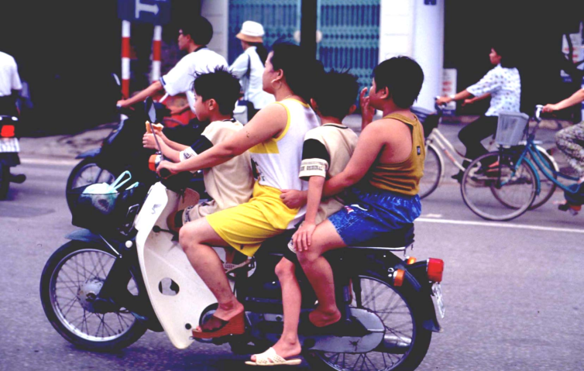
Capacity of other transport modes…
-Railways (in Tokyo)
140 [passengers/car] ×200[%](congestion rate)
×10 (cars long) ×24 [train/hour]
=67,000 [passenger / hour]
-Airports
minimum interval between take-offs or landings
= 3 minutes
→ 14 [hours/day] ×(60/3)×365×2＝200,000 [flights/year]
-motorcycles …
4,000 [vehicles/hour/lane] ??
×(occupancy) 1.5 [passengers/vehicle]?
=6,000 [passengers/hour/lane] ?

Slide 35
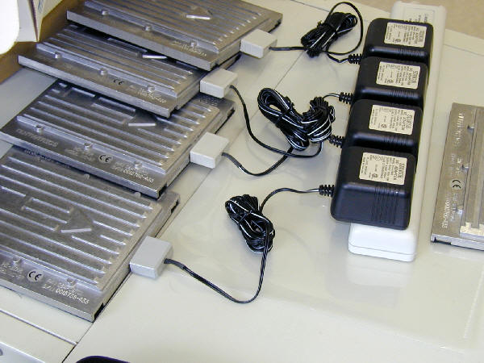
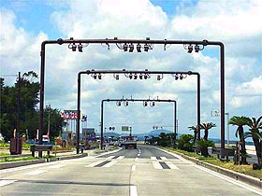
3) Volume
Automatic Traffic Counters
- 24 hours, accurate, easy to restore
Over the road
Under the road

Slide 36

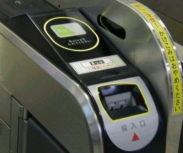
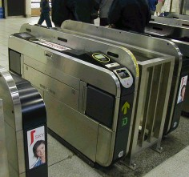
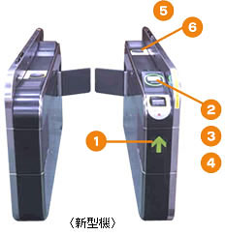
Automatic gate system (Railway)
Automatic gate systems can be used for accurate data collection…
IC card →
Passengers don’t need to insert
the card, only touch it to the machine
New Machine Model

Slide 37
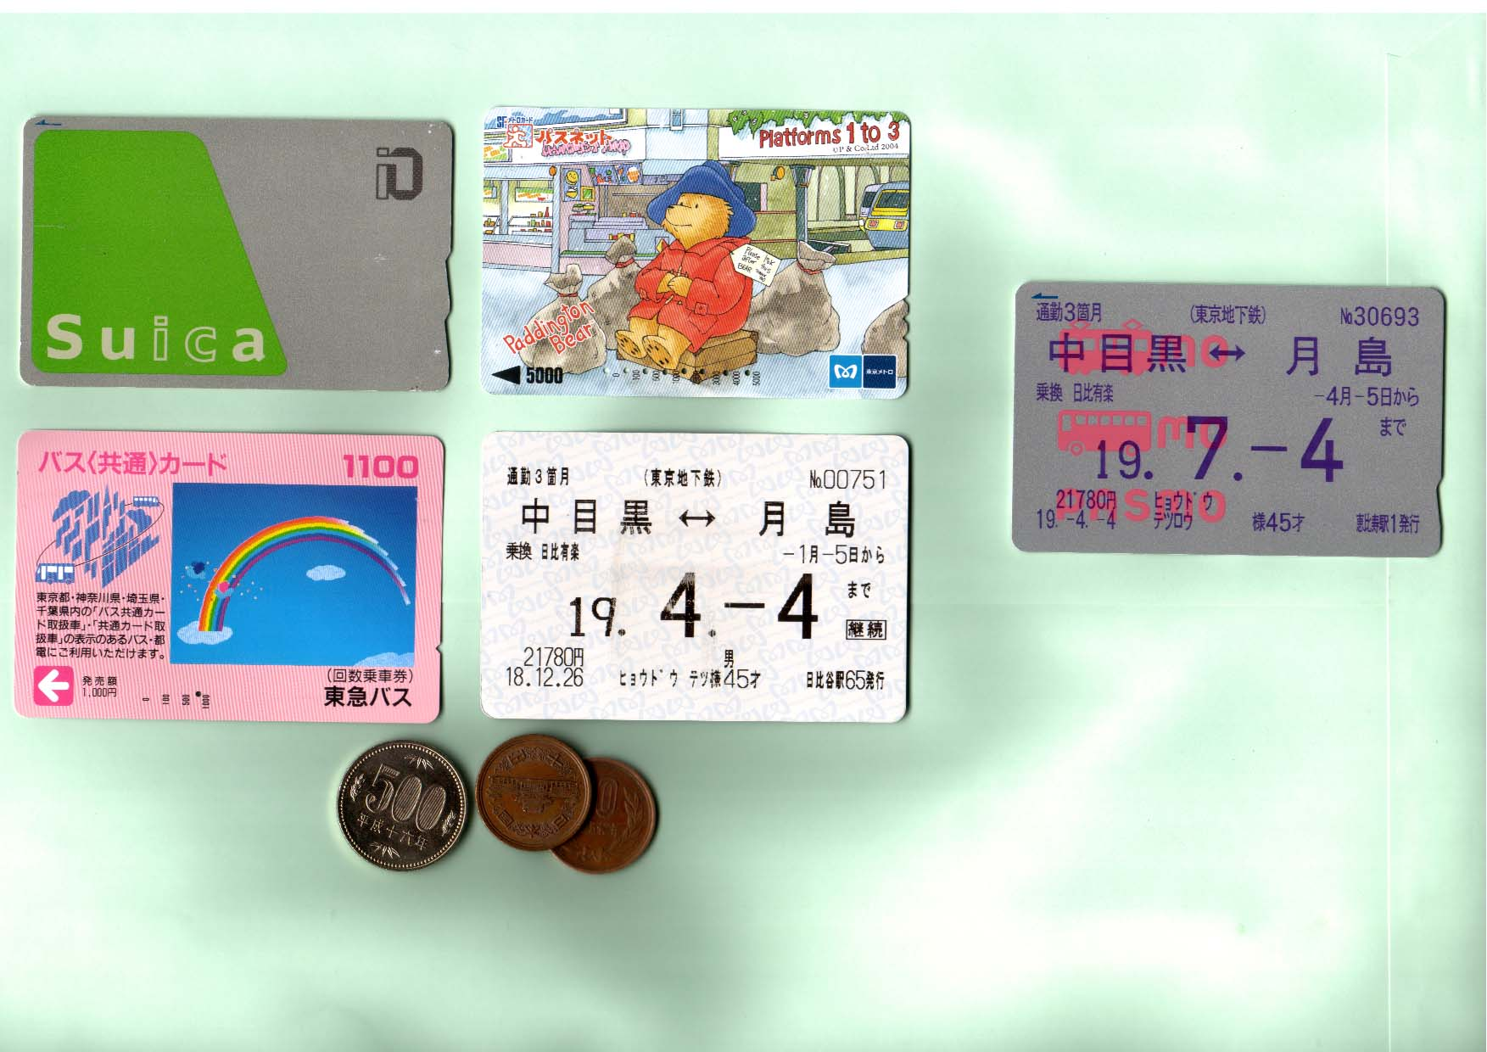
On April 2007, JR+Metro+Bus+Regular Pass were integrated into “PASMO” system

Slide 38
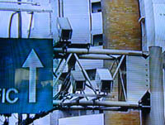
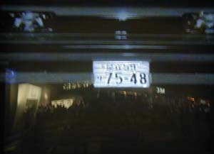
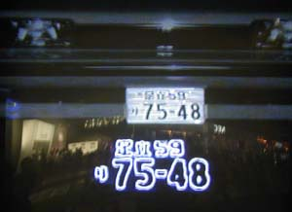
Traffic count by image processing:
Plate number is recorded by image processing
Video camera
-traffic count, velocity, checking for violators…
→
External output
Example:
-Control system
-Monitoring panel output
-Provision of travel time information
Calculation result
Image
Plate number information
Image processor
- Reading of license plate
Image
Travel time information processor
- Verification of license plate information
- Calculation of travel time and speed

Slide 39
4) Performance
“Travel time” is essential information for travelers
“Congestion” is also important
However, they are variables…
→ Real time data acquisition & provision by IT (internet, image processing) have been developing…
→ They can also take an important role to evaluate infrastructure benefits!
- data acquisition → storage → processing → visual presentation
Notes:
4) Performance
Regarding on-going transportation services such as traveling speed and distance of congestion,
multilateral measurement of service levels is also important for checking the effectiveness of transportation
planning. For example, relieving congestion is one easy-to-understand objective in improving
transportation facility, and it is necessary to first acquire accurate data concerning whether congestion
exists or not.
However, distance of congestion or traveling speeds change from time to time, and it is difficult to identify
a typical value. Therefore, for continuous and highly-accurate performance measurement using IT,
measurement of traveling speeds between fixed points on a road, monitoring of train locations,
on-line storage of takeoff/landing times of airplanes, etc. are actually in service.

Slide 40
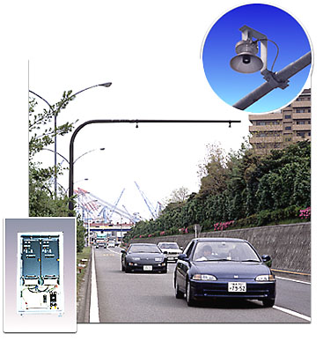

Innovative Performance Survey
- Sensing or Monitoring Technology -
Traffic volume counting system using supersonic waves
Traffic volume & speed measuring system using microwaves
Notes:
3) Volume
For detailed designing of facilities, traffic volume data for each spatial region including spot traffic volume
and incoming and outgoing passengers at a station is required. From the aspect of road traffic,
manual measurement with a counter is the typical method used. However, recently, an apparatus that
automatically measures traffic volume by using a sensor has been popular, and now it is possible to
collect data on-line.
For traffic volume sensors, measurement using radio waves or sound waves over a road is popular in Japan
as shown in the photo on the left. In the United States and Europe, they usually use an apparatus with a sensor
embedded in the road. In addition, a portable type of measuring apparatus has been developed, which is often
used for surveys in developing countries.

Slide 41


Traffic volume & speed measuring system by type of vehicle using an AVI* system
*AVI: Automated Vehicle Identification using Image Processing Technology

Slide 42

Example of Advanced Technology --- Data collection by GPS* ---
*GPS: Global Positioning System
GPS consists of satellites which
enable users to determine their
exact position anywhere on the
surface of the earth at any time.
There are currently 27 satellites
in orbit. At any time there should
be at least four to six satellites
"visible".

Slide 43
Comparison of Speed Profile between Ho Chi Minh (motorbike) and Tokyo (car)
70
60
HCM (motorbike)
50
Tokyo (car)
Km/h
40
30
20
10
0
0
5
10
15
20
25
30
35
40
time (total 40 minutes)
Notes:
As an example, a measurement of simple traveling speed using a GPS apparatus with dramatically
enhanced accuracy will be introduced.
The following figure shows the results of traveling speed surveys of cars in Tokyo and Ho Chi Minh City,
using a portable GPS apparatus, each of which has a weight of about 100g. For example, when a car is
used in Tokyo, you can travel only to the 6km point after 40 minutes. But, in Ho Chi Minh City,
you can travel up to the 12km point.
In this way, by using a GPS apparatus, it is possible to easily confirm, through cross-checking the required time
and the travel distance, that the average speed in Tokyo is 20Km/hour or below, and, in Ho Chi Minh City
where flood of motor bikes are coming and going, it can be seen that traveling is possible at speeds
about twice as fast as in Tokyo.
As seen from the surveys, measurement of mobile objects can be made easily anywhere on the earth,
and, by increasing the number of apparatuses, it is possible to accurately understand performance
of the entire transportation in a city.

Slide 44


Probe vehicle data collecting system:
Output
from the car navigation
Systems
Car Navigation Systems
Memory Card
1.
Converted binary data to text data
2.Converted WGS84
format data to
Data of vehicle behavior
*1
(year, month, day, time, direction,
Local (Tokyo) data
spot speed, latitude, longitude)
3.Converted Greenwich Time to
Tokyo time
GIS
Map matching
Stop status judgment
*2
Pilot Project in Japan
→2000, Tokyo Probe
Vehicle project
Probe Link Master Data

Slide 45


Example of Link Travel Speed
This figure is the result calculating average link travel speed in Tokyo area(10km×10km)
The data covers a six-month period from May to October.
10km
--- 0～20km/h or less
--- 20～40km/h or less
--- 40～60km/h or less
--- 60km/h and above

Slide 46
Example of analysis
Average speed of each link was calculated by day & time
Congestion points & time were confirmed visually

Slide 47

Image Processing Technology for Monitoring
Example of Passenger Vehicle Hours of Delay and Amount of Loss
The result obtained was a loss of 675.1 billion yen (5 billion US＄) for last year in Tokyo
This figure shows the amount of loss in the Tokyo area

Slide 48
Recorded average speed:
By month
By time of day
By day of week
By weather

Slide 49

Probe Rickshaw Survey in 2009
July 14(Tue), 16(Thu), 20(Mon), 22(Wed),
25(Sat), 27(Mon), 30(Thu)
August 2(Sun), 4(Tue)
10 GPS loggers to each rickshaw in each day through rickshaw owner
Total 77 rickshaws’ movements were collected
→ Max. 73 Km travel per day!
Demonstration Program

Slide 50


5 km
Matching to actual map

Slide 51
- Morning peak is 9 am
Operating distance:
- Maximum over 70 km per day!
- Average around 40-50 km/day
Average speed (including stopping) is around 4 [km/h]
?

Slide 52
Velocity [m/min.]
Time
Velocity [m/min.]
Time
What can we get ?
- to distinguish “waiting” or “operating”
- to distinguish “boarding” or “deadhead”
- to count number of trips

Slide 53

2003/07/25 AM7：30～AM8：30
Example of Image Processing Technique (Recorded video from New World Hotel in HCMC Vietnam)

Slide 54




Image Processing
Making Bit-map file （15frames/sec）
Convert to gray scale (255bit file)
Making background scene
Pick up moving objects by the differences

Slide 55


Template Matching
・Template matching for 60 minutes video
・for Motorbike, Passenger car and Bus running on Two lanes road

Slide 56
Results of image processing
 | M-bike | car | truck | total
Volume（/hour） | 6514 | 496 | 181 | 7191
Density（/Km） | 280.7 | 33.3 | 5.4 | 319.3
Speed （Km/h） | 23.99 | 20.52 | 20.99 | 21.83

Slide 57
Time-space map for one minute

Slide 58
Frequency of travel speed
Car
Truck
Motorbike

Slide 59

Output of German Micro simulation
software “VISSIM”

Slide 60
4. Future Perspective of Transportation Surveys
Advanced Technology --- GIS ---
GIS: Geographical Information Systems
Integrate & manage all spatial data:
- transport
- land use
- geography
- water resources
- telecommunication
- area marketing etc.
= An important infrastructure for future transport planning
- for accurate analyses
- for understandable presentations
- as a useful database system
Notes:
5) Space
Space information is essential data for evaluating an alternate spatial draft of facility improvement.
The space information includes various factors such as land use, building location status,
building usage, floor area, large-scale development, facility improvement status and land price
of the area where the transportation facility improvement is executed. By giving comprehensive control,
processing and evaluation to the data which contains such information on location and space,
alternate drafts for facility improvement are examined in an evenhanded manner. In recent years,
development of GIS (Geographic Information Systems) and accumulation/improvement of data
thereof were executed, which supported formation of agreement by expressing both analysis
and evaluation in a visually understandable manner.

Slide 61


Various scaled maps
Example of vehicle route
analysis

Slide 62







NSDI (the National Spatial Data Infrastructure)
Project in the U.S.A.
see http://www.fgdc.gov/

Slide 63

Commercial GIS image…
it provides facility information, not only on transportation,
but also on department stores, banks, hospitals,
restaurants…
GIS may be constructed through commercial market
power ?

Slide 64
Final Remarks:
5 factors again…
Trip
They need to “build”, “check” and “evaluate” transport demand models
Harmonization is also important
Some Information Technologies may lower data acquisition cost
“Disclosure” of each data is also an important factor for further plans
Capacity
Volume
Performance
Space
Transport data is not only for modelers,
The Fruits should be shared with users for better plans !
Notes:
6) Conclusion
Of course, the five factors are important independently. However, since they are closely related
to each other in regards to supply and demand, performance to check their balance, etc., acquisition of data
in a way that either data is neither too much nor too little as a whole should be conducted. In addition,
development of related technologies is ensuring unprecedented economical and highly-accurate surveys,
and there is significant room for devising surveys in developing countries, in particular.
This is a phenomenon that is also seen in Japan, but, when periodical travel Surveys are being implemented,
continuance of surveys will become the objective, and there is a tendency to forget the purpose of the survey.
The survey system should be reviewed, and efficient surveys responding to the objectives of planning should be conducted.

Slide 65

Thank You

